Slide 1
UX Project
Susie Robson
2017
CONFIDENTIAL AND PROPRIETARY

Slide 2
Product: CA Mainframe Application Tuner (MAT)
CA Mainframe Application Tuner (CA MAT) is designed to identify the root causes of application performance inefficiencies in your mainframe applications

Slide 3
The Problem to be Solved
Targeting a new persona for this product
  Application Developers
  There was a need for a new GUI 'Dashboard' screen to present a high level view that an Application Developer could easily understand and use. It was currently mainly being used only by the systems programmer or systems admins.
Need an easy, visual way for them to quickly identify problems they encounter and then fix the problem
They will do this in an Eclipse-based GUI

Slide 4
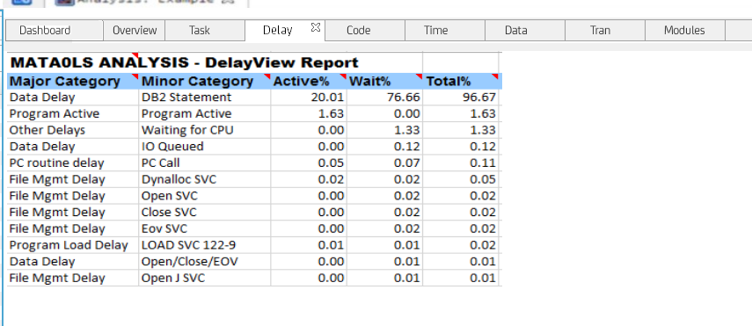
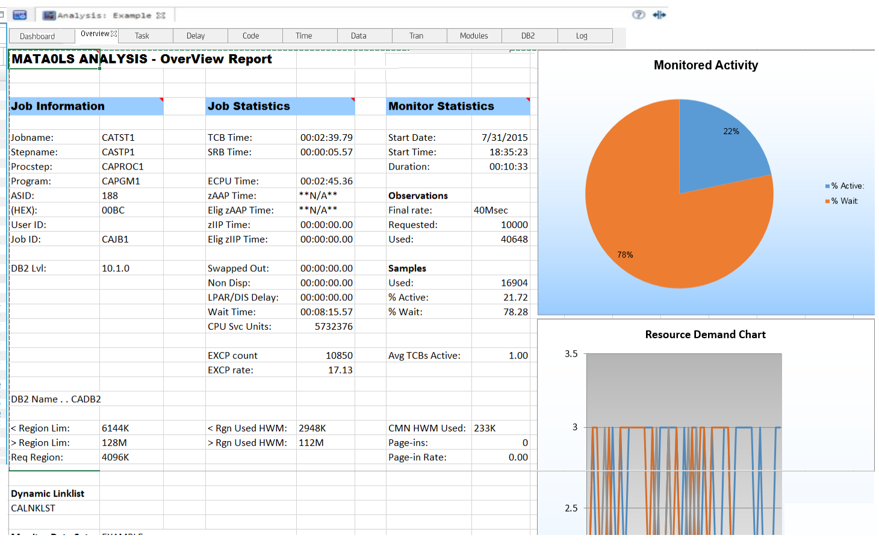
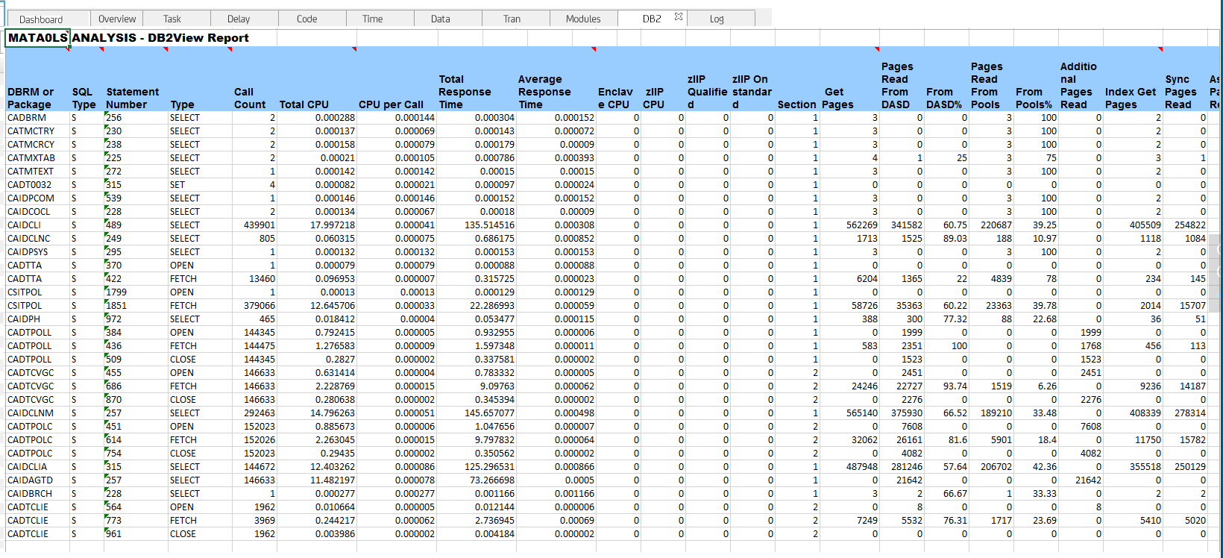
Original Design
Data is across multiple tabs
Difficult to decipher the problem
Tables are large
Notes:
Data is across many tabs, large tables of data, hard to parse through quickly

Slide 5
Collaborative Design Studio
We had a small collaborative Design Studio with the Product Owner, Architect, and Product Manager
We talked about Personas, Use Cases, Workflows, and Designs

Slide 6

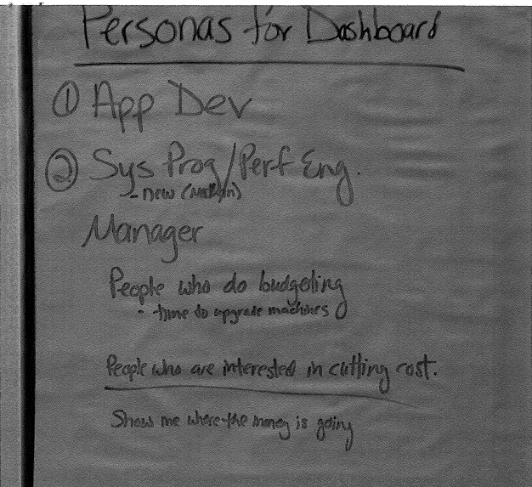
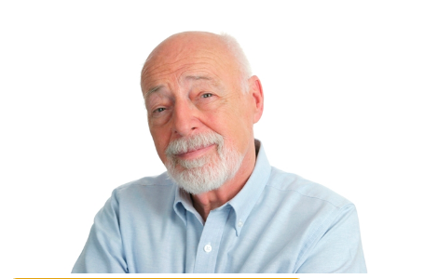
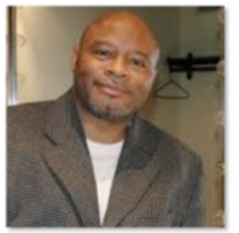
Personas
We identified the top personas
We chose the Application Developer (Michelle) as the target audience
Michelle (app dev)
Ralph (Performance Engineer)
Sherman (sys prog)

Slide 7
Use Cases
A user has been informed that a job is consuming CPU. After analysis
of the job, the dashboard is reviewed to see the top 5 possible causes. Following the path the dashboard leads them to – the job is tweaked and Rerun. A comparison of the dashboard is displayed to see the before & after results.

Slide 8
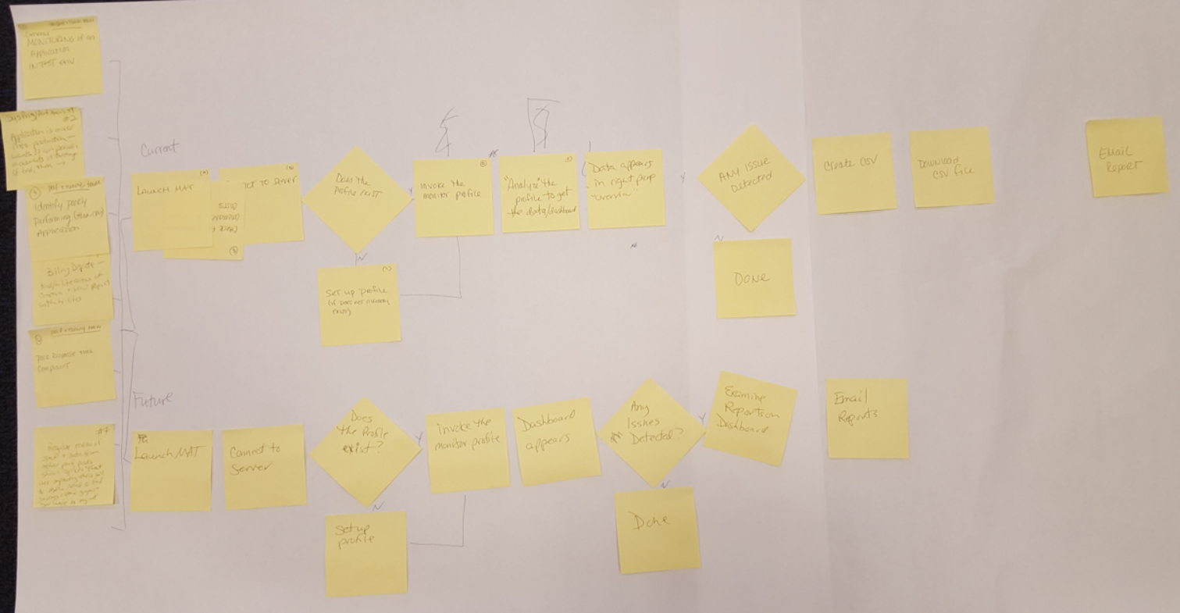
Workflows
Analysis: A workflow was created representing use cases
Notes:
Use cases were provided by the architect and placed into workflow format for better understanding of what steps the user needs to take and what decisions they might incur.
1) Michelle (app dev) codes a new function, she monitors the address space to ensure no new overhead was introduced.
2) Ralph (perf eng) wants to prevent hardware upgrade, he monitors highest consuming resources looking
for changes that can be made to the application.
3) Sherman (sys prog) gets a call that response time is really bad on a CICS region. He runs a couple monitors to check applications statistics to see where improvements
can be made

Slide 9
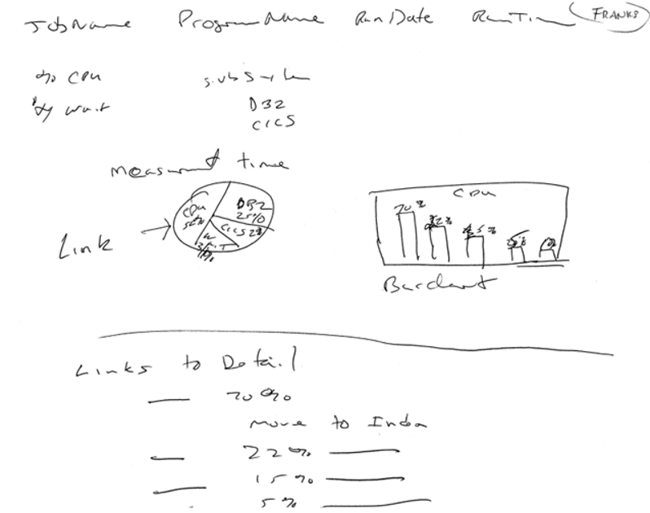
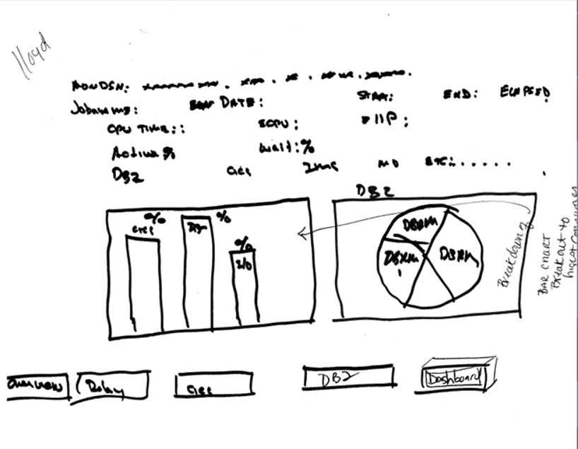
Sketches
After we did the personas, use cases, and workflows we went on to sketching out design ideas based on the use cases that the architect had drafted

Slide 10
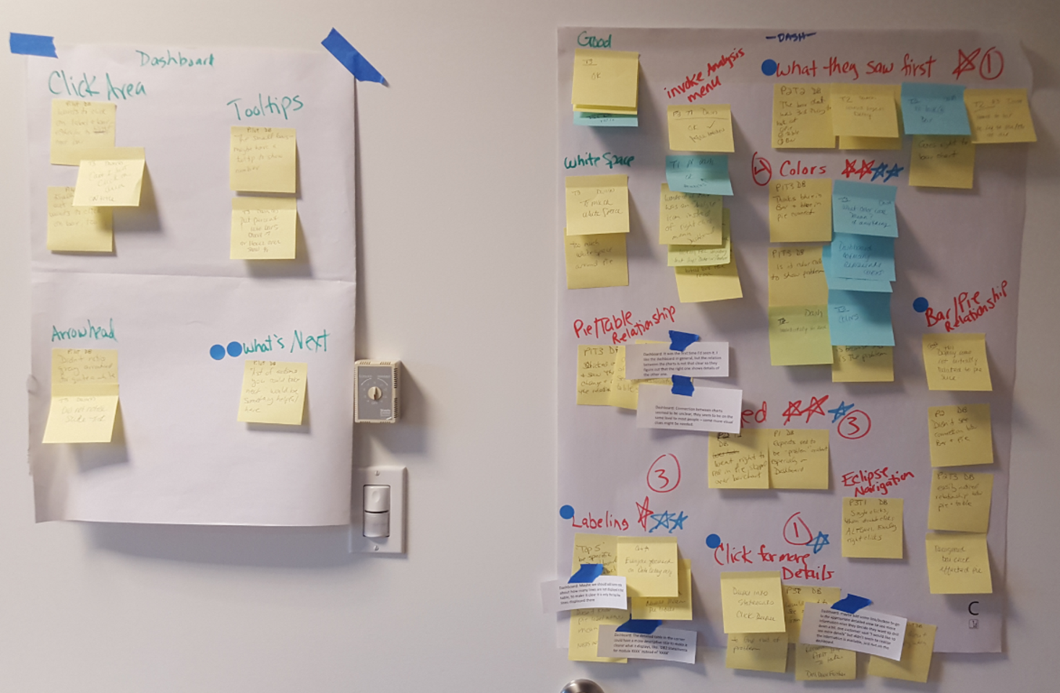
Usability Study Using Paper Prototypes
We created some paper prototypes based on the sketches from the workshop
We conducted a usability study
using the paper prototype
Key stakeholders observed these
sessions and the debrief
We tweaked the design based
on the feedback
We tested again
Notes:
Sketches were used to create a low fidelity paper prototype and conducted usability studies.
Scrum team members who observed the usability tests met and created the affinity diagram.
The Prague scrum teams emailed us their notes they were added to the diagram for voting on top priority items.

Slide 11
Redesign, Higher Fidelity, More Testing
Testing showed the initial pie did not make sense, was not the proper indication of the data. It was just a redundant graphical representation of the total data from the bar chart.
The stacked bar chart misrepresented the data.
Testing revealed that we only needed to display the top 5 items in a dashboard view.
They can always get full data through the individual tabs.
All users liked the direction we were headed in but also wanted the ability to drill deeper into the data. A table layout was added to show the next level of data.
See next page for images

Slide 12
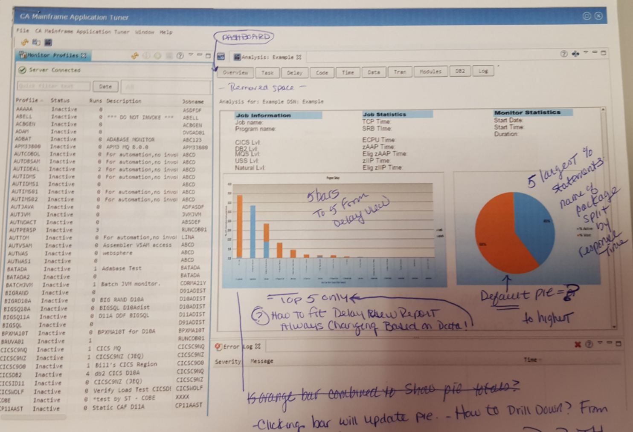
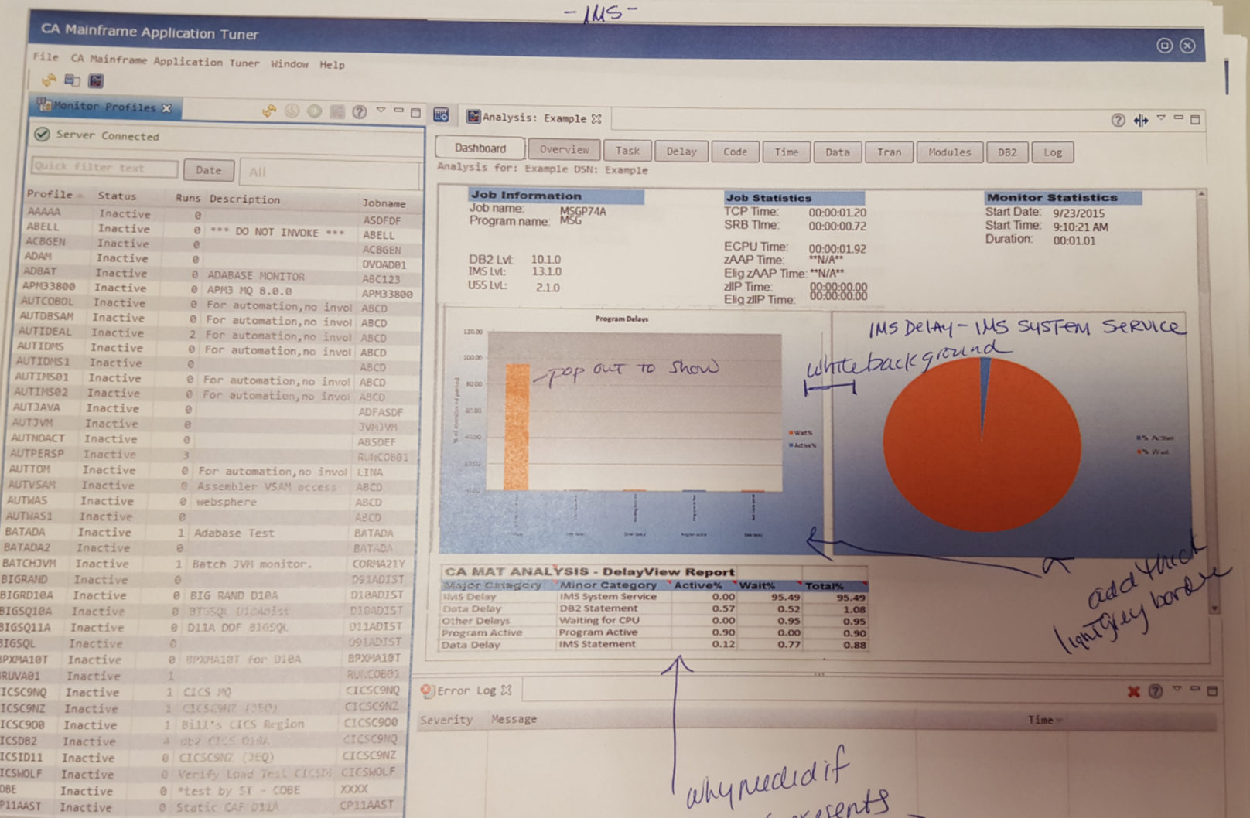
Redesign, Higher Fidelity, More Testing
Before
After
Notes:
Testing showed the initial pie did not make sense, and was not the proper indication of the data we were after.
It was just a redundant graphical representation of the total data from the bar chart.
The stacked bar chart misrepresented the data as ….
Testing revealed that we only needed to display the top 5 items in a dashboard view. They can always get full data thr
All users like the direction we were headed in but also wanted the ability to drill deeper into the data. A table layout was added to show the next level of data.

Slide 13
Axure Wireframes and More Testing
Based on the previous study, the pie chart was updated to represent the top 5% of CPU usage based on the category selected in the Bar chart.
Clicking on an individual slice of the pie updated the table below it to again reflect the top 5% of that item.

Slide 14
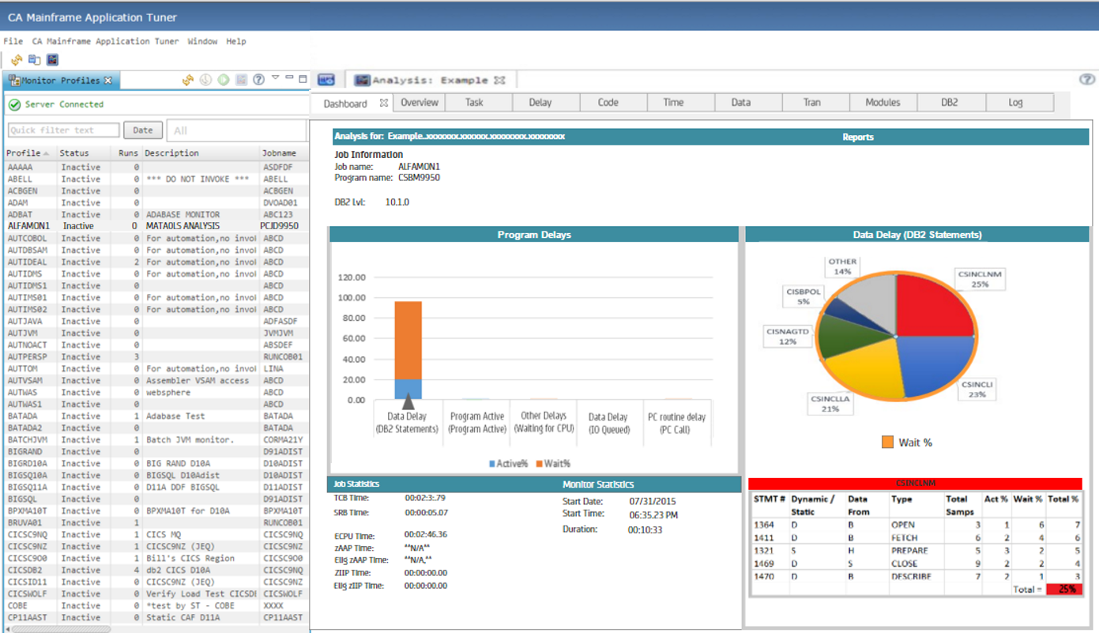
Axure Wireframes
The Red was too strong
Pie Chart was not the appropriate graph
Too much white space

Slide 15
Axure Wireframes and More Testing
New usability tests immediately brought the users eye to the red pie slice, unfortunately now completely ignoring the bar chart on the left.
Our initial thought was the red was a good indication to the trouble area, however, through our testing we found that was not the case. Either active or wait could in fact be troublesome. We found red was guiding the user to focus on an area that might not be the trouble area. Color was adjusted in future designs.
It quickly became apparent that the pie chart was not the way to go as it always wants to total 100% and we found that is not always the case.
Additional development work was done to update the prototype with UX findings/suggestions.

Slide 16
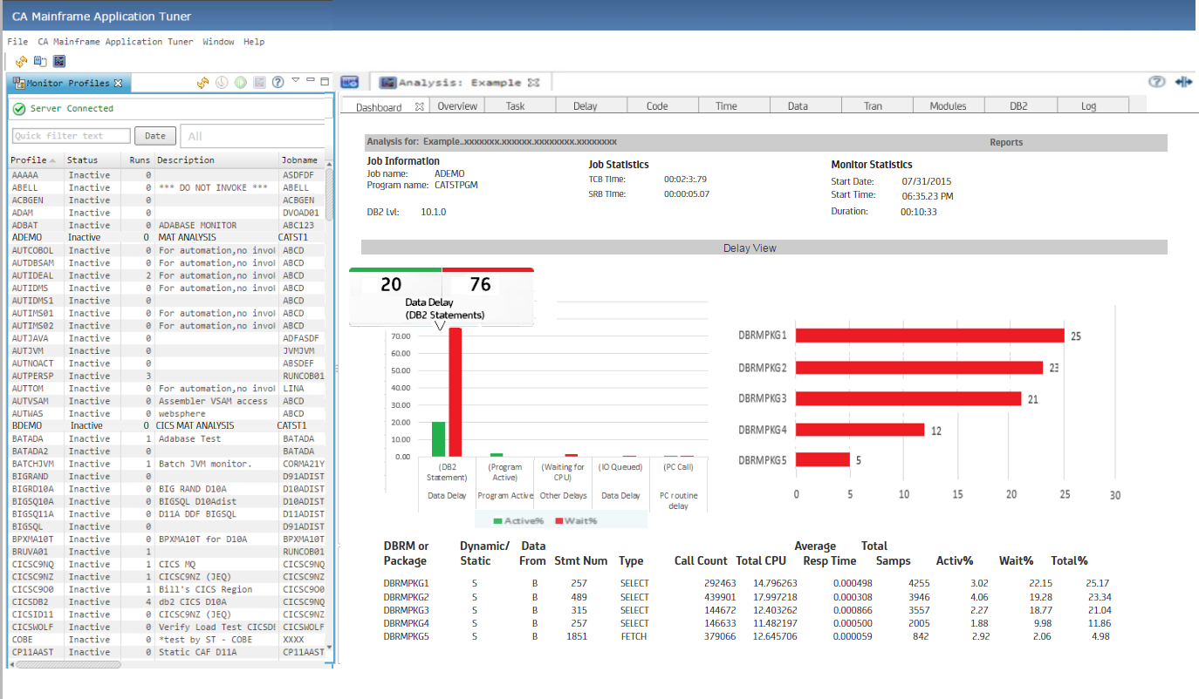
Axure Wireframes and Customer Interviews
We removed the pie chart and played with some bar graphs
The color was not appropriate
But it was testing very well
Customers were really liking it
We followed the corporate style guide

Slide 17
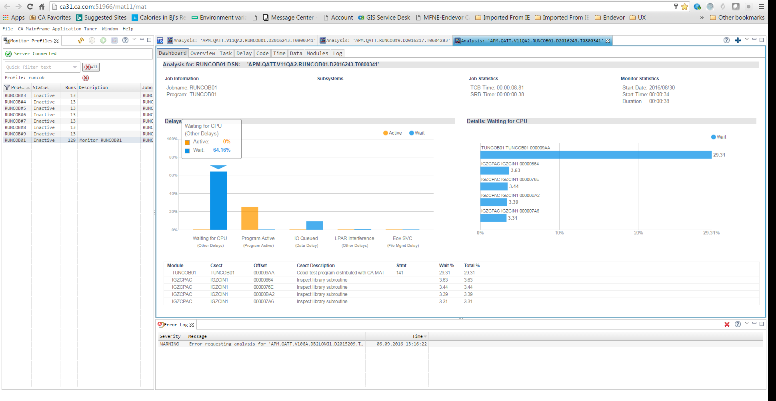
Final UI
The design was updated (more neutral colors, etc.) and again tested
All of the customers who reviewed the new dashboard view thought we were giving great high level information.
Additional agile stories were added to the backlog for enhancements to add reporting / email notifications etc. to the page.

