Slide 1
Susie Robson
Portfolio Review
2020

Slide 2
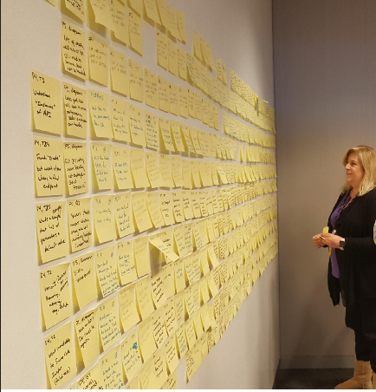
About me
Deep and proven expertise in all aspects of UX research methodologies to improve the User Experience.
Skilled in facilitating the Design Thinking process that begins with Discovery and leads to Solutioning.
Prefers a collaborative environment and excels in mentoring/training others.

Slide 3
Portfolio samples
Design Thinking Workshop (DTW)
Usability Study

Slide 4
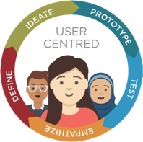
First Project: Design Thinking Workshop

Slide 5
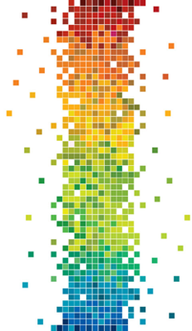
DTW: IDMS
This Discovery workshop targeted a frozen product that the team wanted to revive. The goal was to identify the area where we could make the biggest impact.
Day 1: Discovery
Intro to DT
Hopes and Fears
Personas
Empathy Mapping
Barriers to Outcomes
AS IS Scenarios and Workflows
Pain Points
Day 2: Solutioning
Playback of Day 1
Big Idea Vignettes/Future Vision
TO BE Scenarios and Workflows
Hills (Who What Wow)
Risks and Assumptions
Next Steps/Action Items
Notes:
Integrated Database Management System

Slide 6
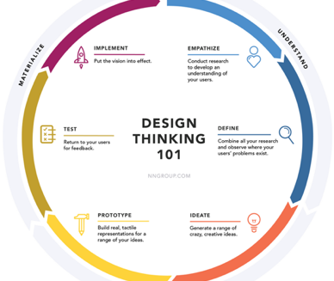
Intro to Design Thinking
Design Thinking was new so we spent some time talking about what Design Thinking is and why it is important.
Notes:
Explore is the bottom third

Slide 7
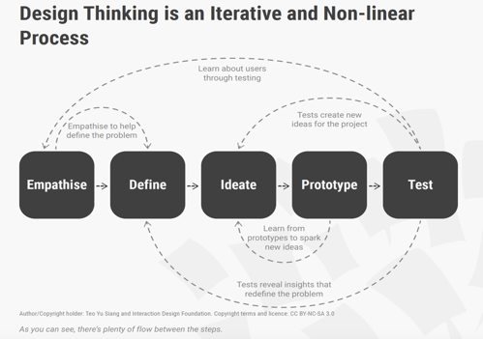

Slide 8
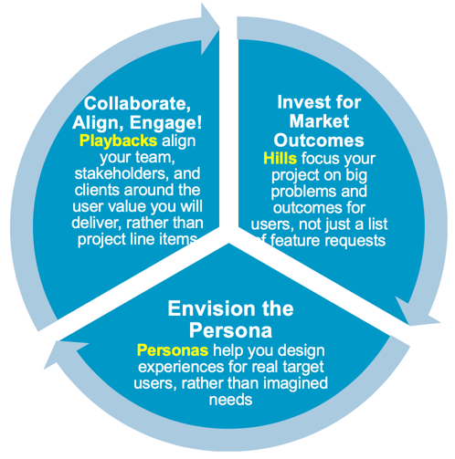
Terminology
We chose to follow the IBM method of Design Thinking though there are other methods to choose from.
This Design Thinking framework uses new terminology so we introduced some of the most used terms that we would be using:
Hills, Personas, and Playbacks

Slide 9
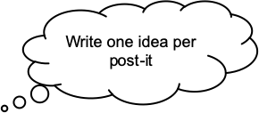


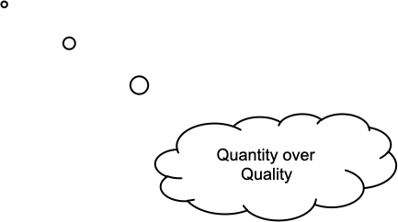
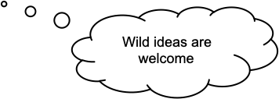
Hopes and Fears
Brainstorming exercise to identify:
What are the outcomes you want to achieve for this project?
What are the outcomes you want to achieve for this workshop?
What are your hopes and fears?

Slide 10

Personas
Introduction to Personas
Identify the project primary and secondary personas
Database Administrators, experienced and new
AppDev
CIO/VP IT/Manager

Slide 11
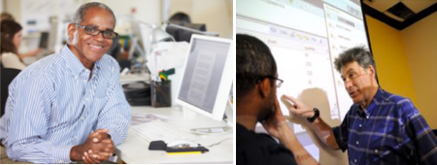
Persona Details
DBA’s
Monitor/maintain system, Databases. Work with appdev/architect -> how application works to streamline performance
Experienced
  Familiar with complexity
New/Green
  Overwhelmed by complexity
  Help needed to know what to do/how
  Fear of failure
Both
  Understands data needs
  Defines databases
  Run utilities
  Back-up/restore
  Configures
  Optimizes

Slide 12

Persona Details
AppDev (see with Architects)
Build programs that access data and execute IDMS commands
Experienced
  Support
  Knowledge
  Use Capabilities
New Gen – new to Integrated Database Management System (IDMS)
  New use applications – need modern languages
  Competitive products
  Mobile?
CIO/VP IT/Manager/decision maker/influencer
Justify benefit of product
Authorize payment/renewals
Notes:
Integrated Database Management System

Slide 13
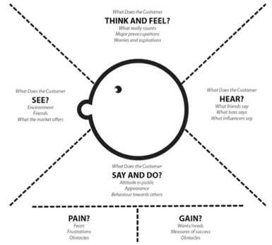
Empathy Mapping
Work with one Persona per team
Use Post-its, fill out each quadrant of the Empathy Map
Think and Feel
See
Hear
Say
Pains
Gains

Slide 14
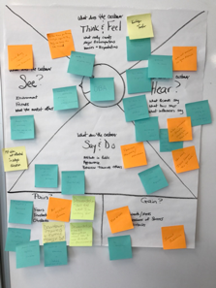

Slide 15
Barriers to Outcome
Teams brainstormed obstacles to success for our users.
Some of the themes:
Knowledge, Skillsets: Aging/declining workforce, lack of training
Complexity: Install/upgrade process is too complex, setting up and configuring SQL and client/server access is difficult for new DBA’s, lack of automation, Unload/Reload/Reorg without outage
Management: not enough people/staff, no time to learn/train
Enhancements: Lack of modern tools, Needs online REORG

Slide 16
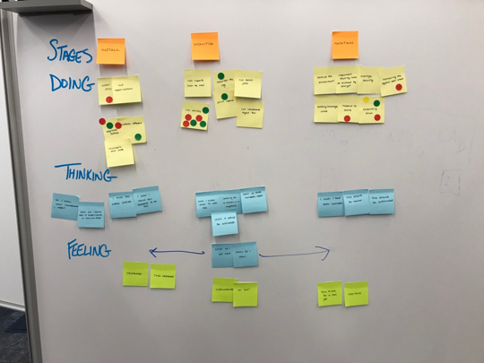
AS IS Scenarios
How are people working today?
What are they doing, thinking and feeling?
Dot vote on importance

Slide 17
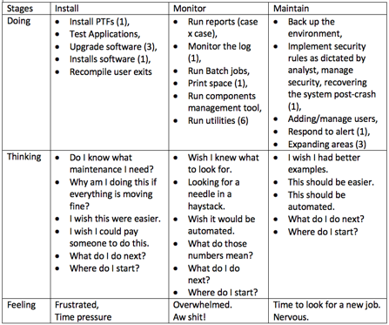
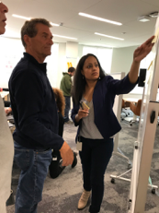
AS IS Scenarios

Slide 18
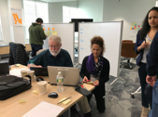
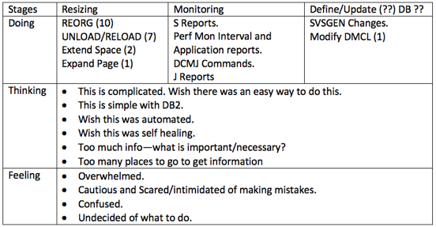
AS IS Scenarios

Slide 19
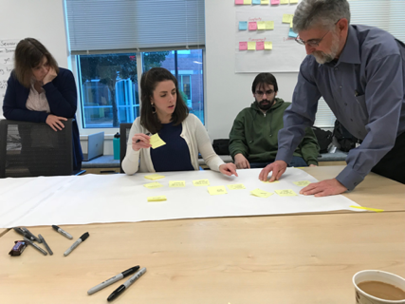
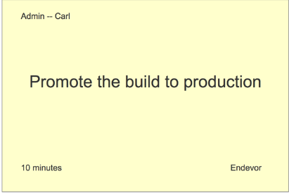
AS IS Workflows
How are people working today? What are the workflows for users today?
They mapped out the workflows that they believe users are doing today.
They identified pain points and put the Pain post-it note next to the step where it occurs

Slide 20
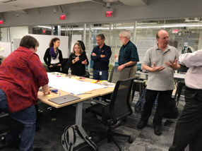
AS IS Workflows
The team created workflows for how they think the use is working today for REORG and UNLOAD/RELOAD

Slide 21
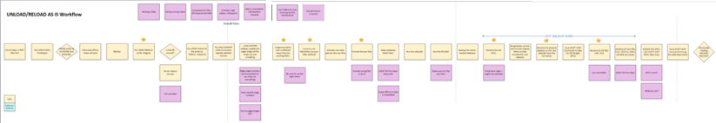
AS IS Unload/Reload Workflow
This is the current workflow (steps are in yellow) and the pain points (pink). Almost every pain point represented a crucial problem that could cause major disruption to the companies business.

Slide 22
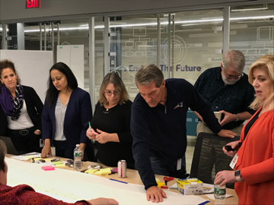
AS IS --> TO BE Workflows
We did a Playback of the AS IS workflows and then mapped out a TO BE workflow that would solve the problems that currently exist and improve the user experience.

Slide 23
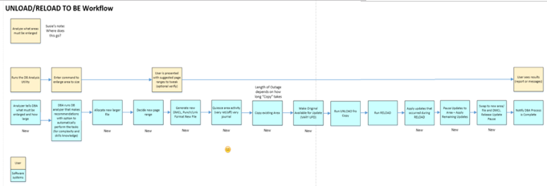
AS IS --> TO BE Workflows
The result:
Simplified a 14+ step database reorganization process into 2-3 steps, preventing opportunities for user error while reducing downtime

Slide 24

Hill Statement
A Hill Statement is a WHO WHAT WOW statement
Any DBA can REORG and/or EXPAND an area with minimal Interaction and no database outage with no interruption to the business.

Slide 25
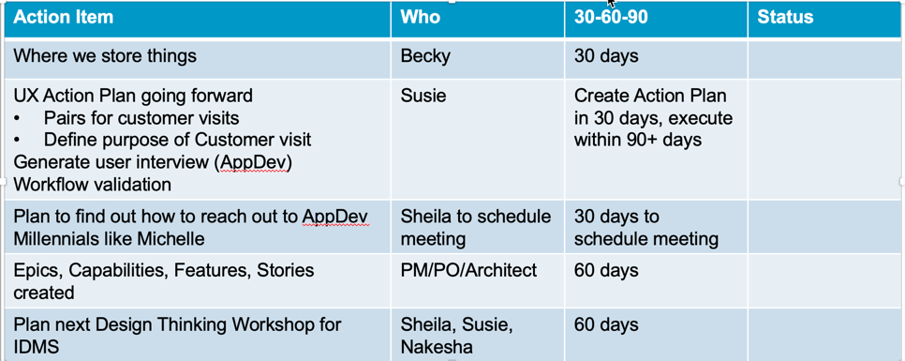
Next Steps/Action Items

Slide 26
Key Learnings
Identified an entire class of users (application programmers) with unmet needs, opening up possibilities for new features and new customers
Identified and brainstormed multiple solutions for multiple pain points in the database reorganization process:
  Complicated manual process leads to fear of mistakes and data loss
  Cost of database downtime
Simplified a 14+ step database reorganization process into 2-3 steps, preventing opportunities for user error while reducing downtime

Slide 27
What would I do differently?
The workshop was a great success but there were some activities that worked better than others.
The Scenarios (Doing, Thinking, Feeling) were not as effective and seemed redundant with the workflows. I would skip the scenarios next time.
All teams worked on the same ideas/workflows. In retrospect, I would have had each team work on something different so we could get more ideas fleshed out to maximize our time together.

Slide 28
Second Project: Usability Study

Slide 29
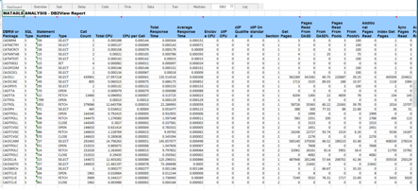
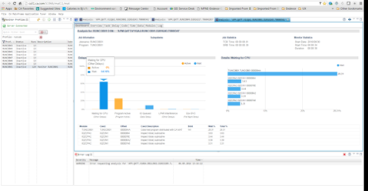
Usability Study series: Mainframe Application Tuner (MAT) Dashboard
Before
CA MAT is designed to identify the root causes of application performance inefficiencies in mainframe applications
This project was more than just a usability study. It combined:
Collaborative design workshop
Paper prototype usability study
Interactive wireframe usability study
Final coded version study
After

Slide 30
The Problem to Solve
Targeting a new persona for this product
  Application Developers
There was a need for a new GUI 'Dashboard' screen to present a high level view that an Application Developer could easily understand and use. It was currently mainly being used only by the systems programmer or systems admins.
Need an easy, visual way for them to quickly identify problems they encounter and then fix the problem
They will do this in an Eclipse-based GUI

Slide 31
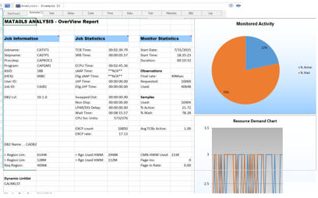
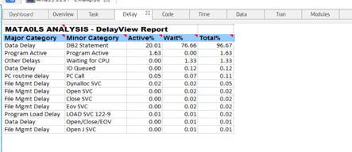
Original Design
Data is across multiple tabs
Difficult to decipher the problem
Tables are too large, overwhelming
Notes:
Data is across many tabs, large tables of data, hard to parse through quickly

Slide 32
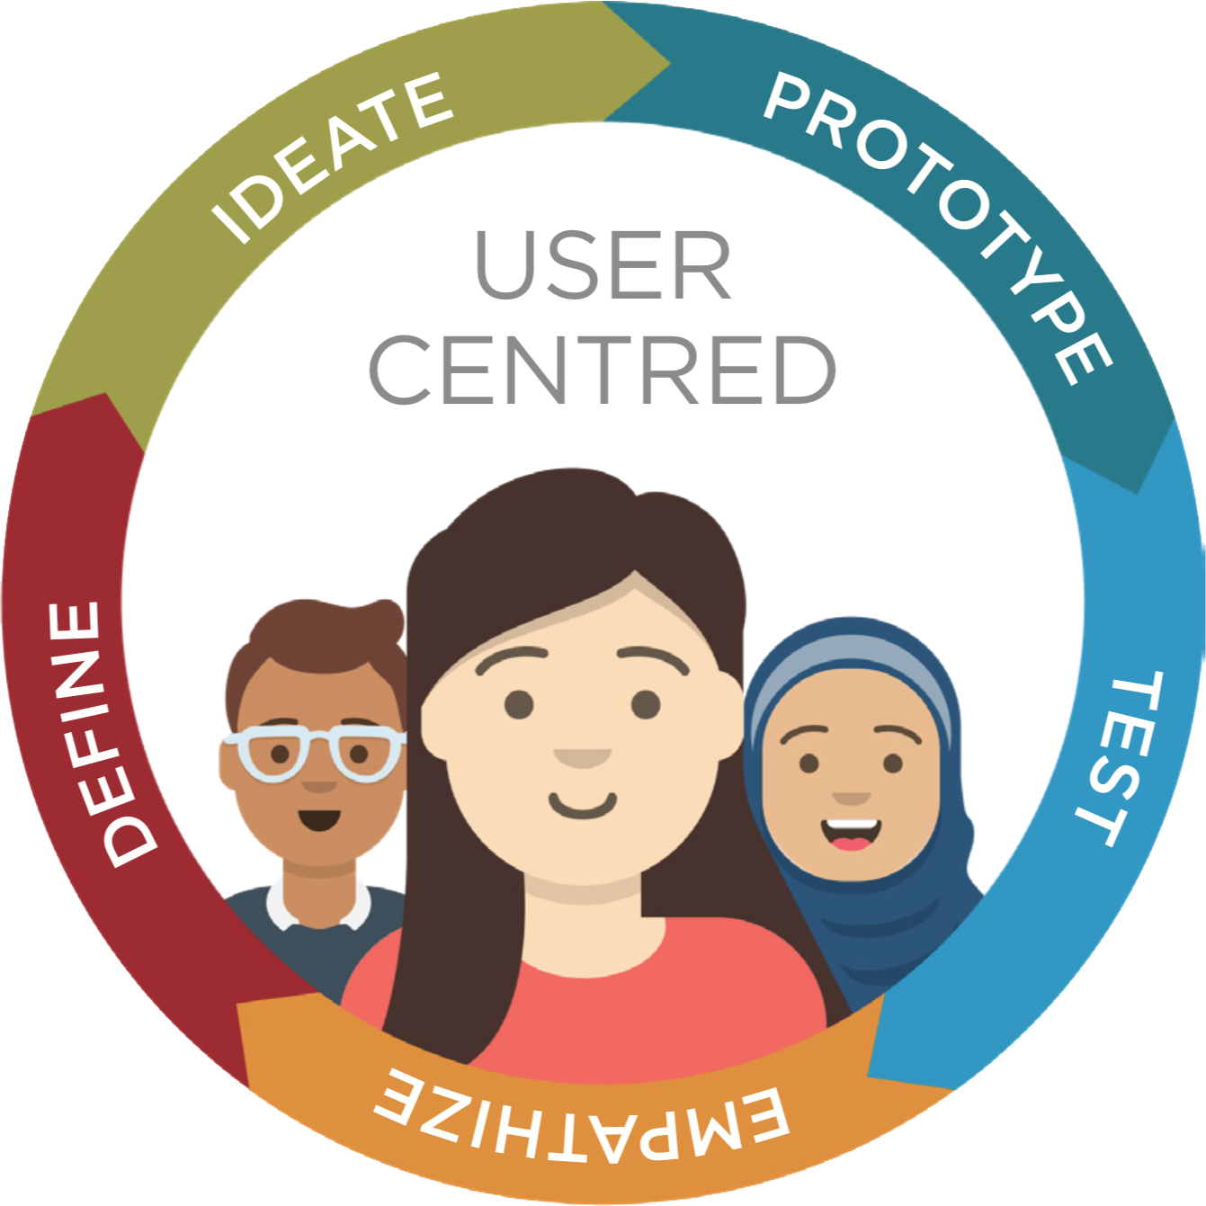
Process
Collaborative Design Studio
Concept testing
Create a paper prototype
Usability test the paper prototype
Tweak the design
Test again
Create an interactive wireframe
Usability test
Tweak
Test
Build

Slide 33
Collaborative Design Studio
We had a small collaborative Design Studio with the Product Owner, Architect, and Product Manager
We identified personas, use cases, workflows, and designs

Slide 34
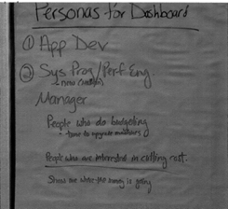

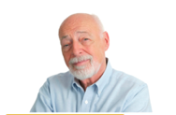
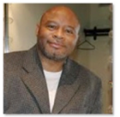
Personas
We identified the top personas
We chose the Application Developer (Michelle) as the target audience for the Dashboard
Michelle (AppDev)
Ralph (Performance Engineer)
Sherman (SysProg)

Slide 35
Use Case
A user has been informed that a job is consuming CPU. After analysis of the job, the dashboard is reviewed to see the top five possible causes. Following the path the dashboard leads them to – the job is tweaked and Rerun. A comparison of the dashboard is displayed to see the before & after results.

Slide 36
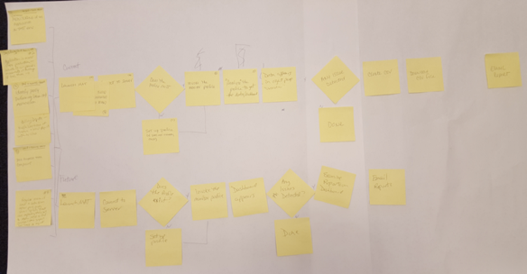
Workflows
A workflow was created that represented the use case
Notes:
Use cases were provided by the architect and placed into workflow format for better understanding of what steps the user needs to take and what decisions they might incur.
1) Michelle (app dev) codes a new function, she monitors the address space to ensure no new overhead was introduced.
2) Ralph (perf eng) wants to prevent hardware upgrade, he monitors highest consuming resources looking
for changes that can be made to the application.
3) Sherman (sys prog) gets a call that response time is really bad on a CICS region. He runs a couple monitors to check applications statistics to see where improvements
can be made

Slide 37
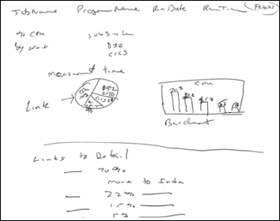
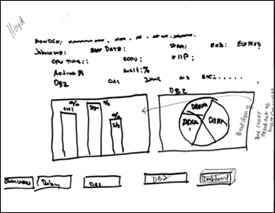
Sketches
After we did the personas, use cases, and workflows, we went on to sketching out design ideas based on the use cases

Slide 38
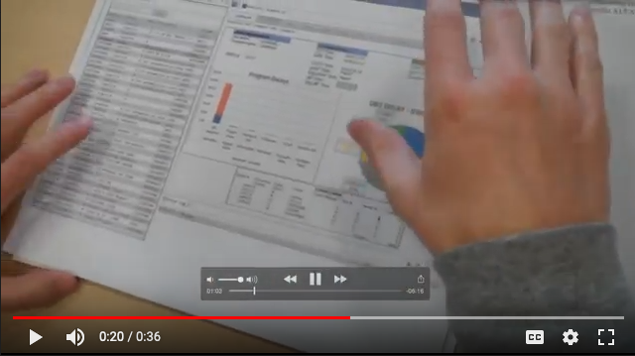
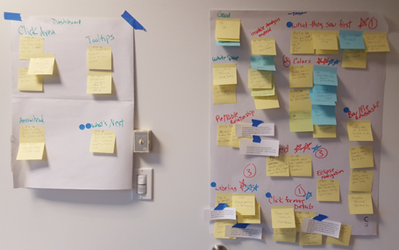
Usability Study Using Paper Prototypes
I created some paper prototypes based on the sketches from the workshop
The paper prototype was used in a usability study that I facilitated
Key stakeholders observed these sessions and participated in the debrief that I led
I tweaked the design based on the feedback
Tested again
Notes:
Sketches were used to create a low fidelity paper prototype and conducted usability studies.
Scrum team members who observed the usability tests met and created the affinity diagram.
The Prague scrum teams emailed us their notes they were added to the diagram for voting on top priority items.

Slide 39
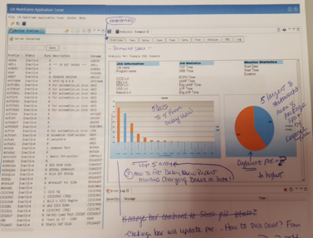
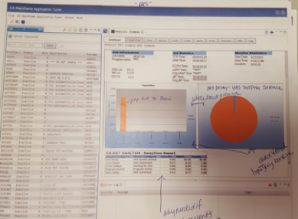
Redesign, Higher Fidelity, More Testing
Testing showed the initial pie did not make sense, was not the proper indication of the data. It was just a redundant graphical representation of the total data from the bar chart.
The stacked bar chart misrepresented the data.
Testing revealed that we only needed to display the top five items in a dashboard view.
They can always get full data through the individual tabs.
All users liked the direction we were headed in but also wanted the ability to drill deeper into the data. A table layout was added to show the next level of data.
Notes:
Testing showed the initial pie did not make sense, and was not the proper indication of the data we were after.
It was just a redundant graphical representation of the total data from the bar chart.
The stacked bar chart misrepresented the data as ….
Testing revealed that we only needed to display the top 5 items in a dashboard view. They can always get full data thr
All users like the direction we were headed in but also wanted the ability to drill deeper into the data. A table layout was added to show the next level of data.

Slide 40
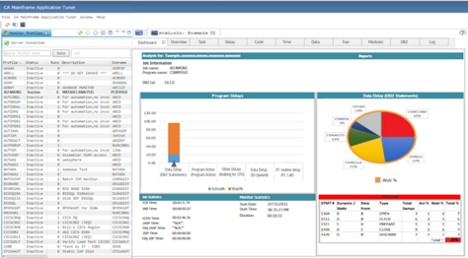
Axure Wireframes, More Testing
Based on the previous study, the pie chart was updated to represent the top 5% of CPU usage based on the category selected in the Bar chart.
Clicking on an individual slice of the pie updated the table below it to again reflect the top 5% of that item.
The Red was too strong
Pie Chart was not the appropriate graph
Too much white space

Slide 41
Axure Wireframes, More Testing
Testing showed the users eyes were drawn to the red pie slice, completely ignoring the bar chart on the left.
I thought red was a good indicator of trouble; however, through our testing we found that was not the case. Either active or wait could in fact be troublesome. Red was guiding the user to focus on an area that might not be the trouble area. Color was adjusted in future designs.
Pie chart was not the right chart as it always wants to total 100% and that is not always the case.
Additional development work was done to update the prototype with UX findings/suggestions.

Slide 42
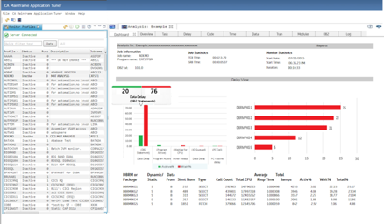
Axure Wireframes, More Testing, Customer Interviews
We removed the pie chart and played with some bar graphs
The color was not appropriate
But it was testing very well
Customers were really liking it
We followed the corporate style guide

Slide 43
Final UI
The design was updated (more neutral colors, etc.) and again tested
All of the customers who reviewed the new dashboard view thought we were giving great high level information.
Additional agile stories were added to the backlog for enhancements to add reporting / email notifications etc. to the page.

Slide 44
What would I do differently?
I would have insisted that more members of the team were involved in the Design Studio at the very beginning.

Slide 45
Other

Slide 46
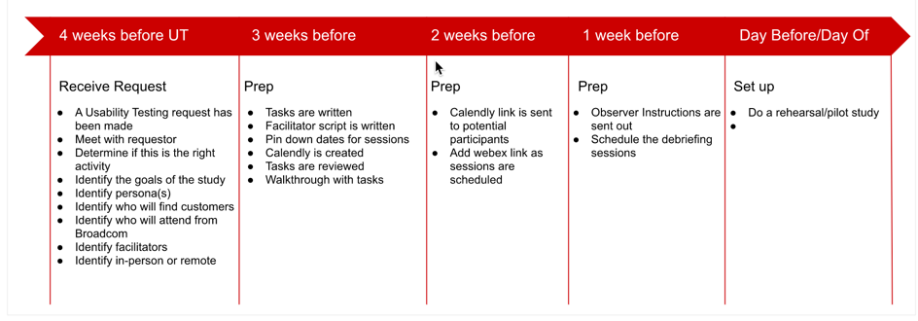
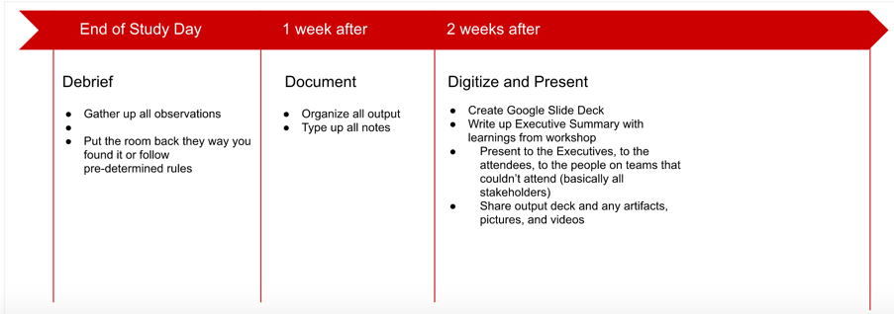
Usability Testing Process

Slide 47
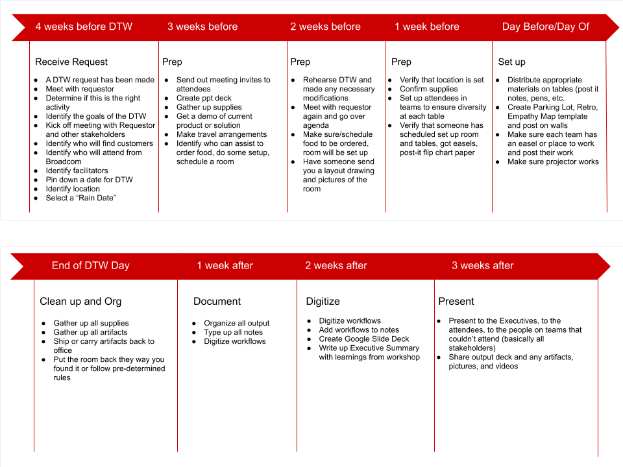
DTW Process

Slide 48
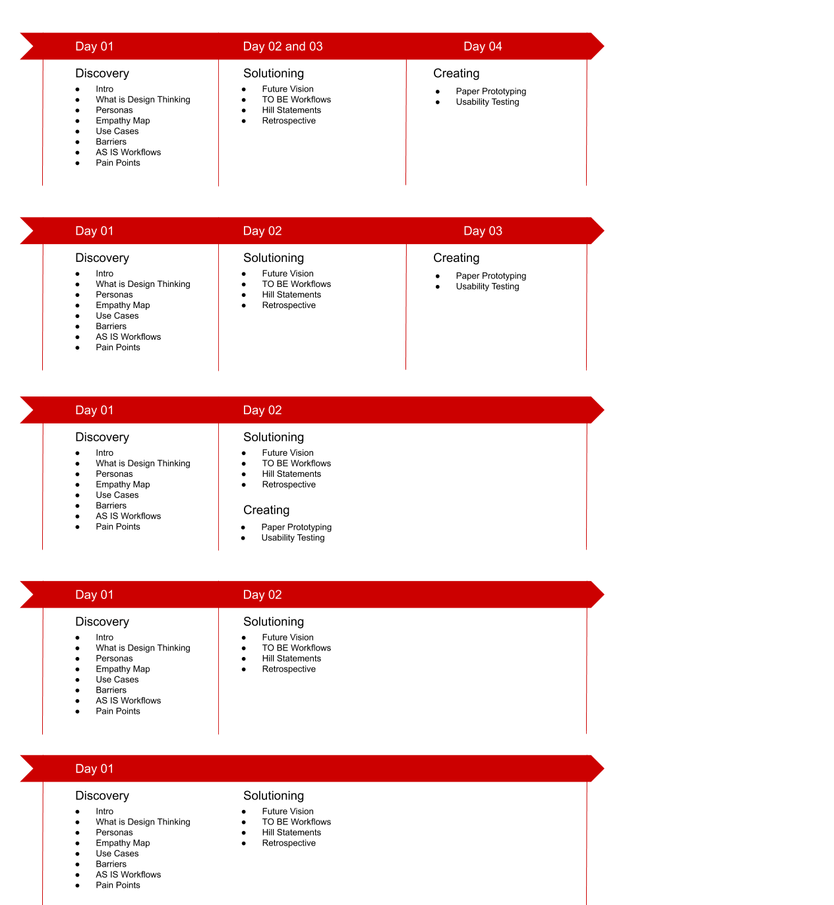
DTW Agendas

Slide 49
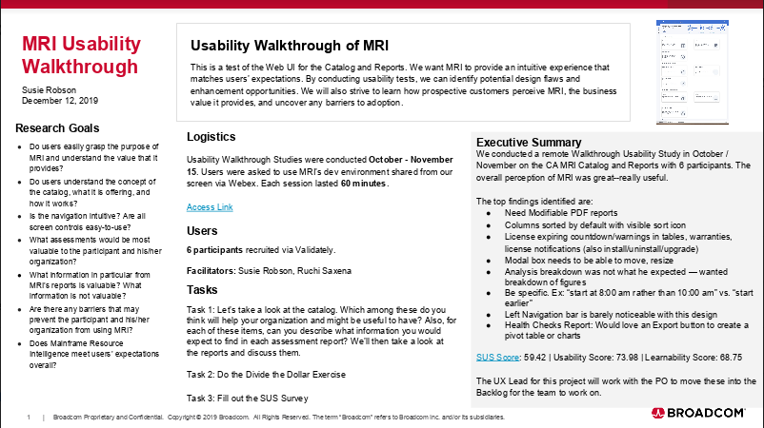
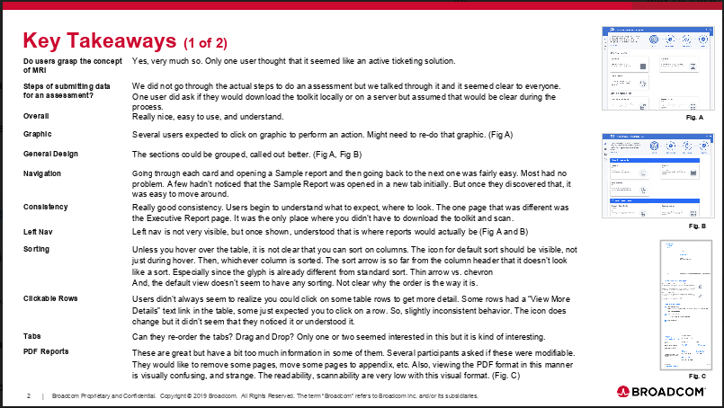
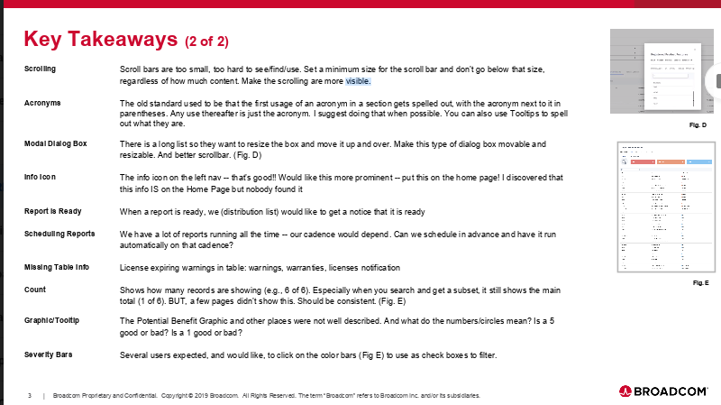
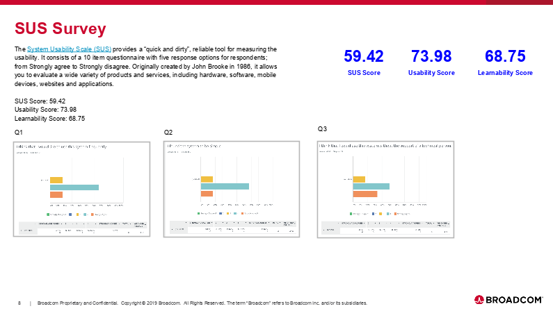
Sample Usability Report

Slide 50

Contact
Susie Robson
susrobson@gmail.com
617-435-1089

