Slide 1
Susie Robson
UX Portfolio 2024

Slide 2
UX Governance Framework
UX Team
January-2024

Slide 3









UX Governance Framework
Channel focus of UX investment
Standard and Guidelines
Roles and Responsibilities
Process and Workflows
Drive consistency in design
Enable design self-service
Training and Education
Compliance and Auditing
Continuous Improvement
Optimize design efficiency
Ensure the user’s needs are at the forefront of design

Slide 4
UX Governance Framework
Standard and Guidelines
Roles and Responsibilities
Process and Workflows
Training and Education
Compliance and Auditing
Continuous Improvement
Establish clear standards and guidelines for UX design, including principles, best practices, design patterns, and accessibility standards.
Establish a set of guiding principles that reflect the organization's values and goals while focusing on delivering an exceptional user experience. Identify which products/projects get full, partial or minimal UX involvement.
It’s essential to have a library of design patterns and reusable components that represent successful solutions to common UX problems. These patterns should cover navigation, form design, data visualization, error handling, and other elements crucial for a seamless user experience.
Incorporate accessibility standards (e.g., WCAG guidelines) into the UX framework to ensure that products or services are usable by individuals with disabilities.

Slide 5
UX Governance Framework
Standard and Guidelines
Roles and Responsibilities
Process and Workflows
Training and Education
Compliance and Auditing
Continuous Improvement
Clearly defined roles and responsibilities of various stakeholders involved in the UX process, such as researchers, designers, developers, documentation, product managers, program managers, and other stakeholders.
Determine the primary stakeholders involved in the UX process, such as researchers, designers, developers, product managers, program and executives.
Define touchpoints and areas where these stakeholders need to collaborate, ensuring a cohesive UX strategy.
Adapt as necessary based on changing project requirements, team dynamics, or evolving UX methodologies.
Continuously improve these definitions based on insights gained from projects and stakeholder feedback.

Slide 6
UX Governance Framework
Standard and Guidelines
Roles and Responsibilities
Process and Workflows
Training and Education
Compliance and Auditing
Continuous Improvement
Identify which products/projects get full, partial or minimal UX involvement. Outline the processes and workflows for designing, testing, and iterating on UX, ensuring alignment with the overall product/feature development lifecycle.
Identify stages, key milestones, and decision points where UX processes intersect or play a crucial role.
Identify where UX activities such as research, design, prototyping, testing, and iteration fit into the product development phases (e.g., ideation, design, development, testing, launch, post-launch).
Identify collaboration points between UX teams and other departments (e.g., product management, engineering, executives) at each stage.
Develop visual representations (such as workflow diagrams or maps) that illustrate the sequence and dependencies of UX activities within the product development lifecycle.

Slide 7









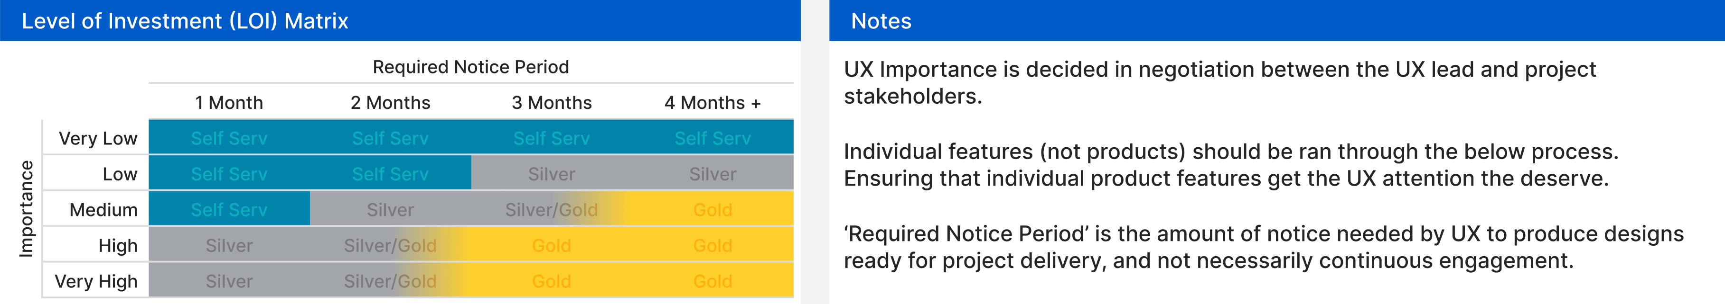





UX Governance Framework
Standard and Guidelines
Roles and Responsibilities
Training and Education
Compliance and Auditing
Continuous Improvement
Process and Workflows
Do not remove!
UX Design & Research Strategy
Rigorous Discovery Research
Low-Fidelity Wireframes/Mocks
High-Fidelity Wireframes/Mocks
Functional Prototype
Usability Testing on Prototype
Senior Stakeholder Checkpoint/Sign-off
Consultation Through Development
UX Design & Research Strategy
Some Discovery Research
(where time allows)
Mid-Fidelity Wireframes/Flat images
Light Usability Testing on Wireframes
Stakeholder Checkpoint/Review
Consultation Through Development
Consultation Through Design
Consultation Through Development

Slide 8
UX Governance Framework
Standard and Guidelines
Roles and Responsibilities
Training and Education
Compliance and Auditing
Continuous Improvement
Do not remove
Process and Workflows
UX Design & Research Strategy
Rigorous Discovery Research
Low-Fidelity Wireframes/Mocks
High-Fidelity Wireframes/Mocks
Functional Prototype
Usability Testing on Prototype
Senior Stakeholder Checkpoint/Sign-off
Consultation Through Development
UX Design & Research Strategy
Some Discovery Research
(where time allows)
Mid-Fidelity Wireframes/Flat images
Light Usability Testing on Wireframes
Stakeholder Checkpoint/Review
Consultation Through Development
Consultation Through Design
Consultation Through Development

Slide 9
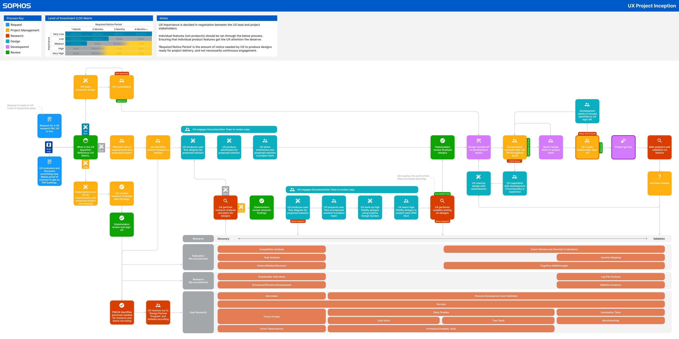
UX Governance Framework
Standard and Guidelines
Roles and Responsibilities
Training and Education
Compliance and Auditing
Continuous Improvement
Process and Workflows

Slide 10
UX Governance Framework
Standard and Guidelines
Roles and Responsibilities
Process and Workflows
Training and Education
Compliance and Auditing
Continuous Improvement
Offer training programs and resources to upskill teams on UX principles, methodologies, and tools. Enable projects with little or no UX input to design in accordance to UX guidelines and practices.
Offer training sessions on UX best practices and methodologies to stakeholders who are engaged in the UX process. Offer access to additional learning resources such as online courses, design tools, and communities to encourage continuous learning beyond the training sessions.
Provide advanced training where needed to the UX Team members to ensure designers and researchers stay up-to-date with the latest methodologies and best practices.
Offer training and awareness of all available Sophos UX tools (Storybook, Design System, Figma) to enable stakeholders to support UX in low UX involvement projects.
Provide ongoing support and guidance to team members as they apply their new skills in their daily work. Offer mentorship or additional sessions as needed.

Slide 11
UX Governance Framework
Standard and Guidelines
Roles and Responsibilities
Process and Workflows
Training and Education
Compliance and Auditing
Continuous Improvement
Ensure compliance with UX request process, industry standards, best practices, and conduct periodic audits to assess adherence to UX guidelines.
Ensure that UX guidelines are integrated into the design and development workflows from the initial stages of ideation to the final product release.
Conduct UX guideline audits on designs and development. Provide details of methodologies, audit frequency, and the scope of each audit.
Develop action plans to address these issues, involving relevant stakeholders and assigning responsibilities for corrective measures.
Ensure a UX audit is a phase-gated milestone at the definition of done.

Slide 12
UX Governance Framework
Standard and Guidelines
Roles and Responsibilities
Process and Workflows
Training and Education
Compliance and Auditing
Continuous Improvement
Create mechanisms for collecting and incorporating feedback from users, stakeholders, and relevant parties to continuously improve UX.
Determine specific objectives for collecting feedback, such as improving usability, identifying pain points, validating design decisions, or aligning with business goals.
Develop structured processes for collecting, organizing, and analyzing feedback received from various sources (incl FullStory).
Ensure users are at the heart of everything we do. Talking directly with them on a regular basis using appropriate research methodologies (such as, usability studies, contextual enquiries, user interviews)
Analyze collected feedback systematically to identify recurring patterns, trends, and critical issues. Prioritizing feedback based on impact, frequency, and alignment with UX objectives.
Communicate improvements or changes made based on insights derived from data and testing to project stakeholders.
Foster a culture of continuous improvement by analyzing data, usability tests, and evolving UX practices based on insights and changing user needs.

