Slide 1
Susie Robson
Portfolio Review
2024

Slide 2
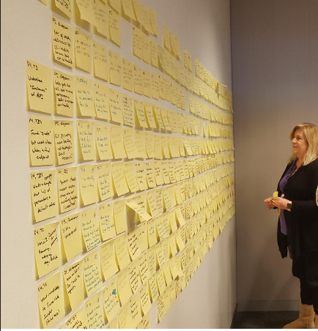
About me
Deep and proven expertise in all aspects of UX research methodologies to improve the User Experience.
Skilled in facilitating the Design Thinking process that begins with Discovery and leads to Solutioning.
Prefers a collaborative environment and excels in mentoring/training others.

Slide 3
Portfolio samples
Design Thinking Workshop (DTW)
Design and Usability Testing Project

Slide 4
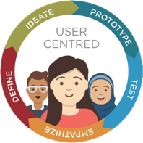
First Project: Design Thinking Workshop

Slide 5

Design Thinking Workshops (DTW)
I introduced DTWs into the company in 2014 and have updated the process throughout that time. In 2019, I put together a template with scripts for others to use.
As interest grew, a colleague and I put together a training program for Design Thinking and Design Thinking Workshops and traveled to our offices around the world to present the training.
Notes:
Integrated Database Management System

Slide 6
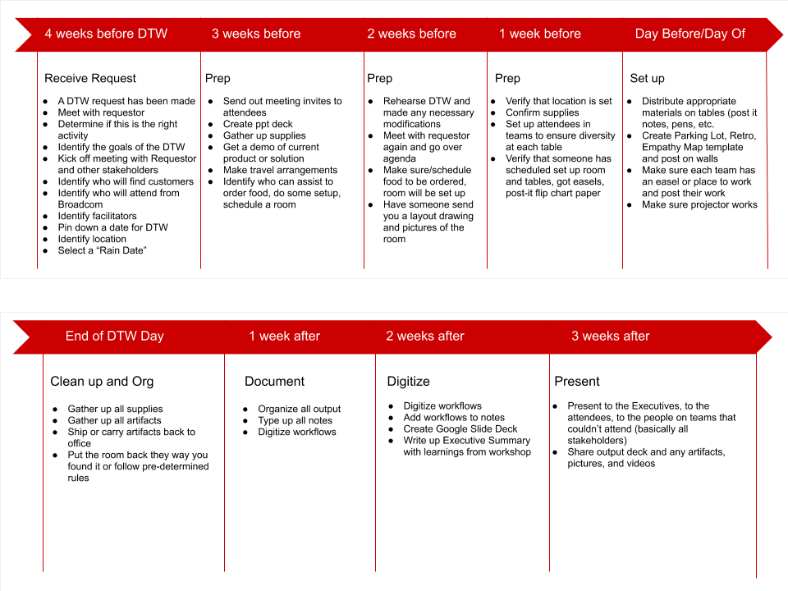
DTW Process

Slide 7
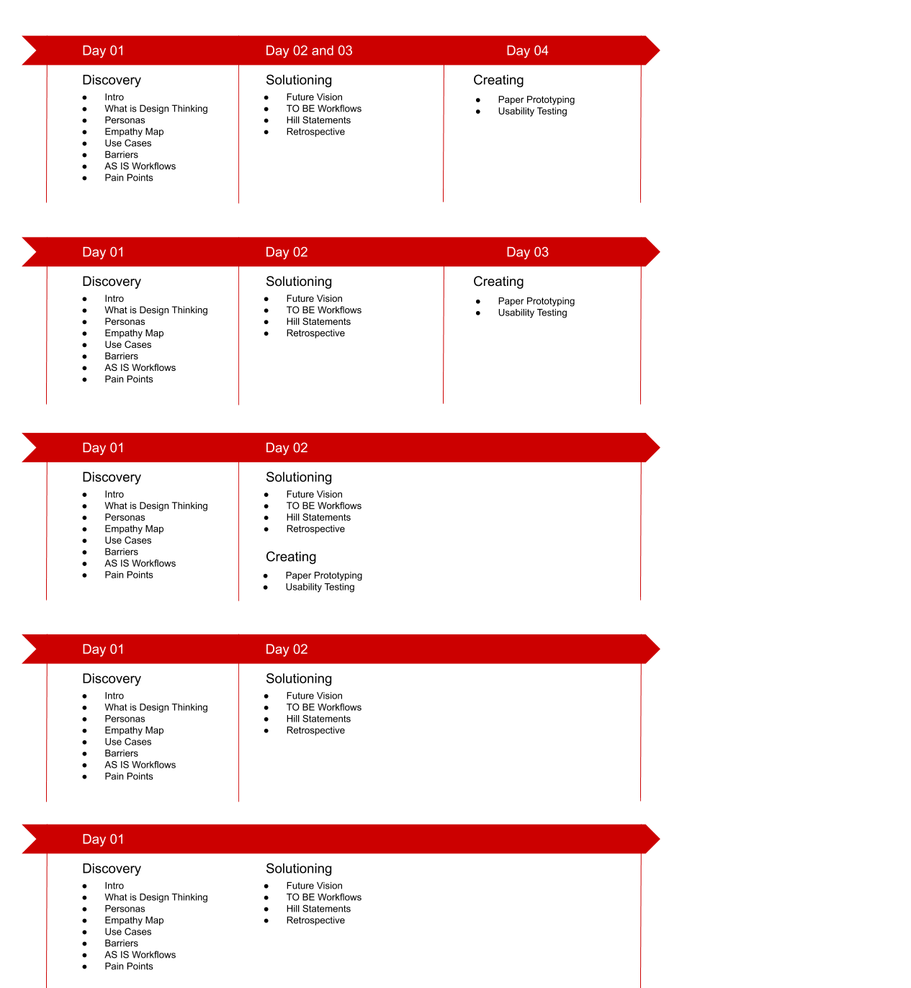
DTW Agendas

Slide 8
DTW: IDMS
This Discovery workshop targeted a frozen product that the team wanted to revive. The goal was to identify the area where we could make the biggest impact.
Day 1: Discovery
Intro to DT
Hopes and Fears
Personas
Empathy Mapping
Barriers to Outcomes
AS IS Scenarios and Workflows
Pain Points
Day 2: Solutioning
Playback of Day 1
Big Idea Vignettes/Future Vision
TO BE Scenarios and Workflows
Hills (Who What Wow)
Risks and Assumptions
Next Steps/Action Items
Notes:
Integrated Database Management System

Slide 9
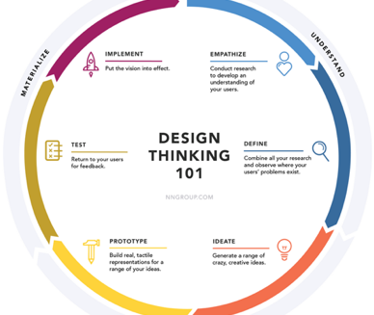
Intro to Design Thinking
Design Thinking was new so we spent some time talking about what Design Thinking is and why it is important.
Notes:
Explore is the bottom third

Slide 10
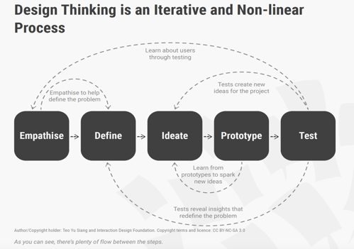

Slide 11
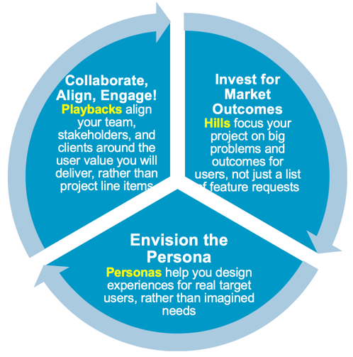
Terminology
We chose to follow the IBM method of Design Thinking though there are other methods to choose from.
This Design Thinking framework uses new terminology so we introduced some of the most used terms that we would be using:
Hills, Personas, and Playbacks

Slide 12
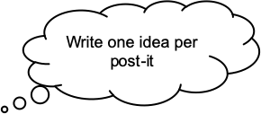


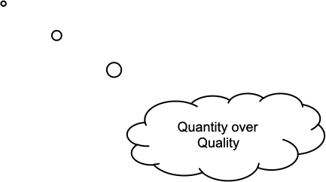
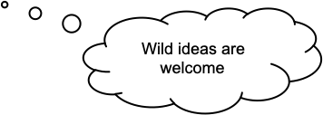
Hopes and Fears
Brainstorming exercise to identify:
What are the outcomes you want to achieve for this project?
What are the outcomes you want to achieve for this workshop?
What are your hopes and fears?

Slide 13

Personas
Introduction to Personas
Identify the project primary and secondary personas
Database Administrators, experienced and new
AppDev
CIO/VP IT/Manager

Slide 14

Persona Details
DBA’s
Monitor/maintain system, Databases. Work with appdev/architect -> how application works to streamline performance
Experienced
  Familiar with complexity
New/Green
  Overwhelmed by complexity
  Help needed to know what to do/how
  Fear of failure
Both
  Understands data needs
  Defines databases
  Run utilities
  Back-up/restore
  Configures
  Optimizes

Slide 15

Persona Details
AppDev (see with Architects)
Build programs that access data and execute IDMS commands
Experienced
  Support
  Knowledge
  Use Capabilities
New Gen – new to Integrated Database Management System (IDMS)
  New use applications – need modern languages
  Competitive products
  Mobile?
CIO/VP IT/Manager/decision maker/influencer
Justify benefit of product
Authorize payment/renewals
Notes:
Integrated Database Management System

Slide 16
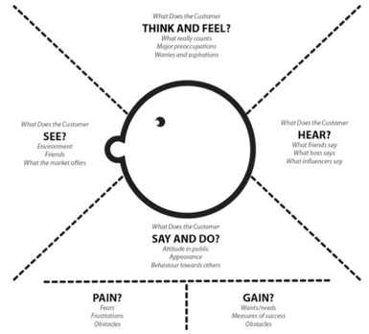
Empathy Mapping
Work with one Persona per team
Use Post-its, fill out each quadrant of the Empathy Map
Think and Feel
See
Hear
Say
Pains
Gains

Slide 17
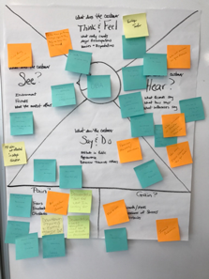

Slide 18
Barriers to Outcome
Teams brainstormed obstacles to success for our users.
Some of the themes:
Knowledge, Skillsets: Aging/declining workforce, lack of training
Complexity: Install/upgrade process is too complex, setting up and configuring SQL and client/server access is difficult for new DBA’s, lack of automation, Unload/Reload/Reorg without outage
Management: not enough people/staff, no time to learn/train
Enhancements: Lack of modern tools, Needs online REORG

Slide 19
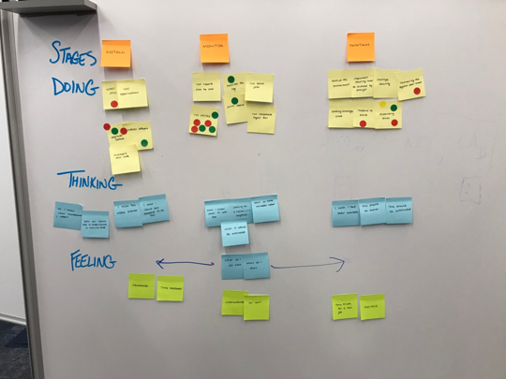
AS IS Scenarios
How are people working today?
What are they doing, thinking and feeling?
Dot vote on importance

Slide 20
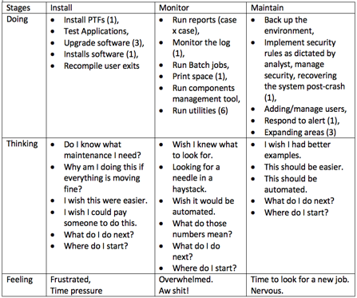
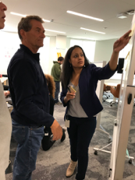
AS IS Scenarios

Slide 21
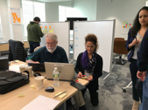
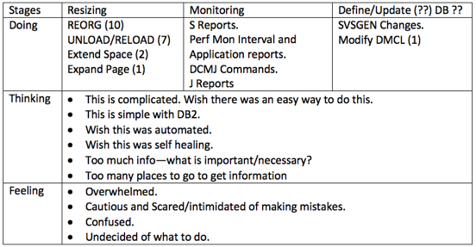
AS IS Scenarios

Slide 22
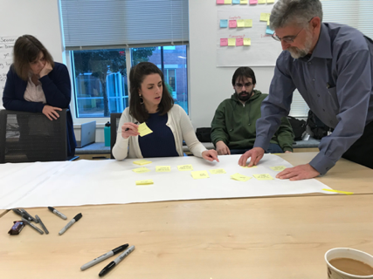
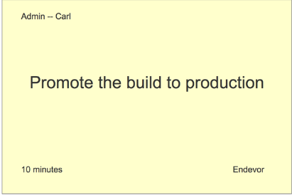
AS IS Workflows
How are people working today? What are the workflows for users today?
They mapped out the workflows that they believe users are doing today.
They identified pain points and put the Pain post-it note next to the step where it occurs

Slide 23
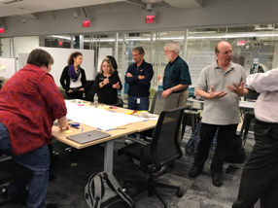
AS IS Workflows
The team created workflows for how they think the use is working today for REORG and UNLOAD/RELOAD

Slide 24
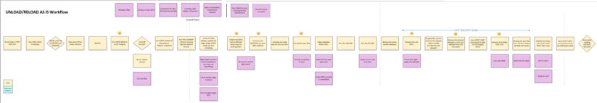
AS IS Unload/Reload Workflow
This is the current workflow (steps are in yellow) and the pain points (pink). Almost every pain point represented a crucial problem that could cause major disruption to the companies business.

Slide 25
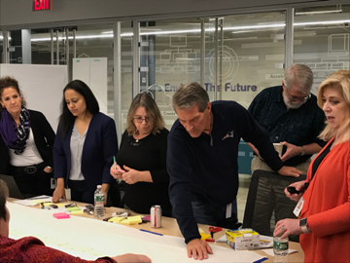
AS IS --> TO BE Workflows
We did a Playback of the AS IS workflows and then mapped out a TO BE workflow that would solve the problems that currently exist and improve the user experience.

Slide 26
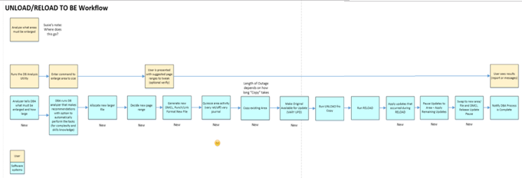
AS IS --> TO BE Workflows
The result:
Simplified a 14+ step database reorganization process into 2-3 steps, preventing opportunities for user error while reducing downtime

Slide 27

Hill Statement
A Hill Statement is a WHO WHAT WOW statement
Any DBA can REORG and/or EXPAND an area with minimal Interaction and no database outage with no interruption to the business.

Slide 28
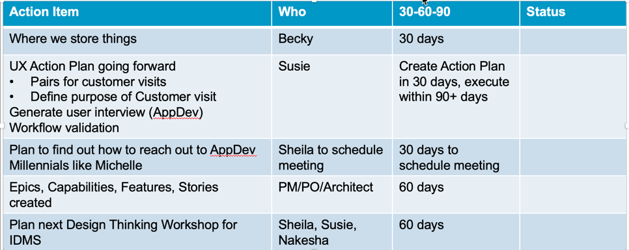
Next Steps/Action Items

Slide 29
Key Learnings
Identified an entire class of users (application programmers) with unmet needs, opening up possibilities for new features and new customers
Identified and brainstormed multiple solutions for multiple pain points in the database reorganization process:
  Complicated manual process leads to fear of mistakes and data loss
  Cost of database downtime
Simplified a 14+ step database reorganization process into 2-3 steps, preventing opportunities for user error while reducing downtime

Slide 30
Benefits
The team was aligned on the goals and what to work on for the next several Pis
The discussions helped everyone to understand what their role was in moving this project forward and the agile stories were written quickly and in a more useful manner
The workflows were printed out and used throughout the project

Slide 31
What would I do differently?
The workshop was a great success but there were some activities that worked better than others.
The Scenarios (Doing, Thinking, Feeling) were not as effective and seemed redundant with the workflows. I would skip the scenarios next time.
All teams worked on the same ideas/workflows. In retrospect, I would have had each team work on something different so we could get more ideas fleshed out to maximize our time together.

Slide 32
Second Project: Iterative Design with Usability Study

Slide 33
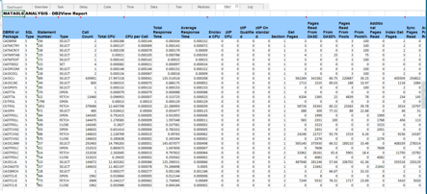
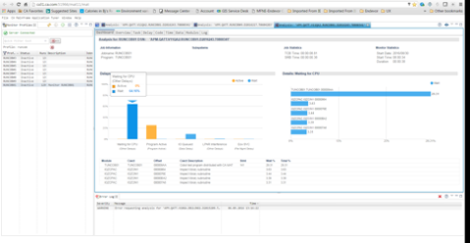
Usability Study series: Mainframe Application Tuner (MAT) Dashboard
Before
CA MAT is designed to identify the root causes of application performance inefficiencies in mainframe applications
This project was more than just a usability study. It combined:
Collaborative design workshop
Paper prototype usability study
Interactive wireframe usability study
Final coded version study
After

Slide 34
The Problem to Solve
Targeting a new persona for this product
  Application Developers
There was a need for a new GUI 'Dashboard' screen to present a high level view that an Application Developer could easily understand and use. It was currently mainly being used only by the systems programmer or systems admins.
Need an easy, visual way for them to quickly identify problems they encounter and then fix the problem
They will do this in an Eclipse-based GUI

Slide 35
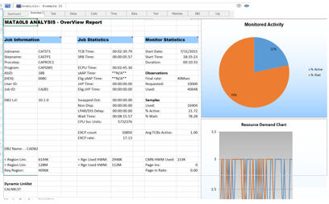
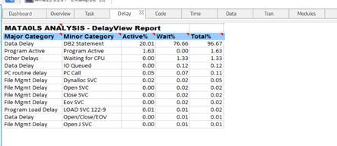
Original Design
Data is across multiple tabs
Difficult to decipher the problem
Tables are too large, overwhelming
Notes:
Data is across many tabs, large tables of data, hard to parse through quickly

Slide 36
UX Design Process Overview
Analysis
Design
Specification
Create paper prototype
Usability test
Test paper prototype with end users
Revise prototype
Test again
Create detailed mockup in Axure
Use components from the Design System
Final usability test
Collaborative Design Studio
Identify all use cases (tasks)
Assumptions, Triggers, Goals
Notated Design
Create workflow diagram
Incorporates all use cases

Slide 37
Collaborative Design Studio
I facilitated a small collaborative Design Studio with the Product Owner, Architect, and Product Manager
We identified personas, use cases, workflows, and sketches

Slide 38
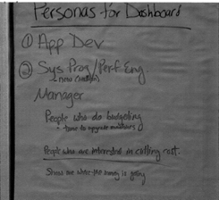



Personas
We identified the top personas
We chose the Application Developer (Michelle) as the target audience for the Dashboard
Michelle (AppDev)
Ralph (Performance Engineer)
Sherman (SysProg)

Slide 39
Use Case
A user has been informed that a job is consuming CPU. After analysis of the job, the dashboard is reviewed to see the top five possible causes. Following the path the dashboard leads them to – the job is tweaked and Rerun. A comparison of the dashboard is displayed to see the before & after results.

Slide 40
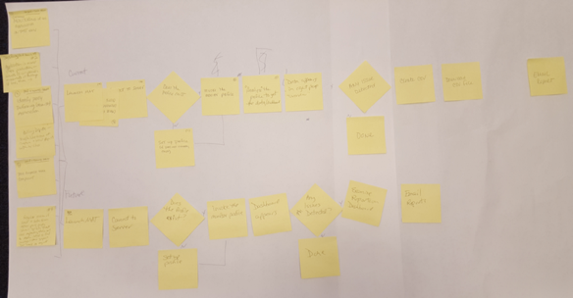
Workflows
A workflow was created that represented the use case
Notes:
Use cases were provided by the architect and placed into workflow format for better understanding of what steps the user needs to take and what decisions they might incur.
1) Michelle (app dev) codes a new function, she monitors the address space to ensure no new overhead was introduced.
2) Ralph (perf eng) wants to prevent hardware upgrade, he monitors highest consuming resources looking
for changes that can be made to the application.
3) Sherman (sys prog) gets a call that response time is really bad on a CICS region. He runs a couple monitors to check applications statistics to see where improvements
can be made

Slide 41
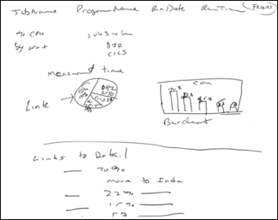
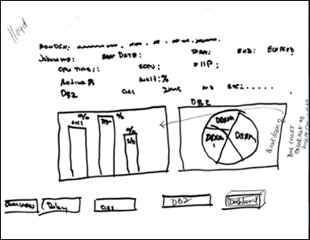
Sketches
After we did the personas, use cases, and workflows, we went on to sketching out design ideas based on the use cases

Slide 42
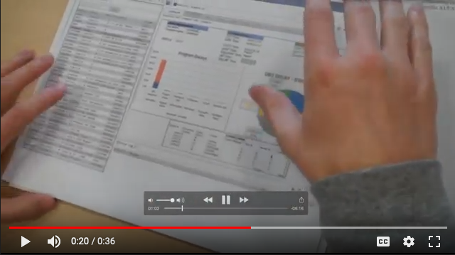
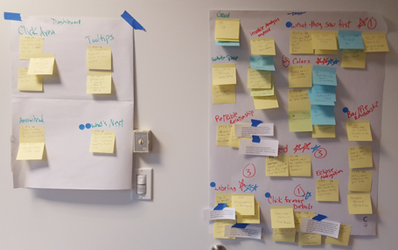
Usability Study Using Paper Prototypes
I created some paper prototypes based on the sketches from the workshop
The paper prototype was used in a usability study that I facilitated
Key stakeholders observed these sessions and participated in the debrief that I led
I tweaked the design based on the feedback
Tested again
Notes:
Sketches were used to create a low fidelity paper prototype and conducted usability studies.
Scrum team members who observed the usability tests met and created the affinity diagram.
The Prague scrum teams emailed us their notes they were added to the diagram for voting on top priority items.

Slide 43
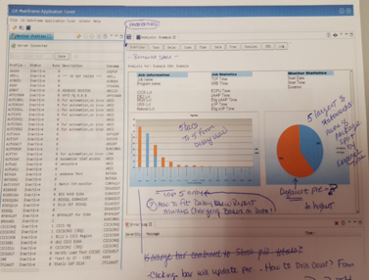
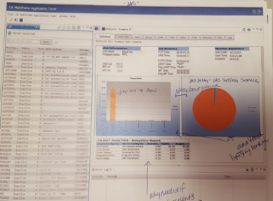
Redesign, Higher Fidelity, More Testing
Testing showed the initial pie did not make sense, was not the proper indication of the data. It was just a redundant graphical representation of the total data from the bar chart.
The stacked bar chart misrepresented the data.
Testing revealed that we only needed to display the top five items in a dashboard view.
They can always get full data through the individual tabs.
All users liked the direction we were headed in but also wanted the ability to drill deeper into the data. A table layout was added to show the next level of data.
Notes:
Testing showed the initial pie did not make sense, and was not the proper indication of the data we were after.
It was just a redundant graphical representation of the total data from the bar chart.
The stacked bar chart misrepresented the data as ….
Testing revealed that we only needed to display the top 5 items in a dashboard view. They can always get full data thr
All users like the direction we were headed in but also wanted the ability to drill deeper into the data. A table layout was added to show the next level of data.

Slide 44
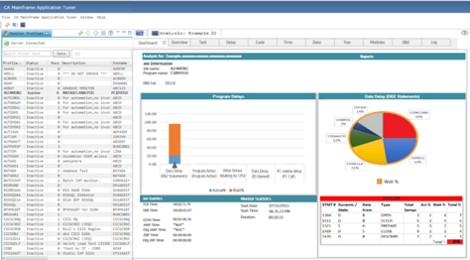
Axure Wireframes, More Testing
Based on the previous study, the pie chart was updated to represent the top 5% of CPU usage based on the category selected in the Bar chart.
Clicking on an individual slice of the pie updated the table below it to again reflect the top 5% of that item.
The Red was too strong
Pie Chart was not the appropriate graph
Too much white space

Slide 45
Axure Wireframes, More Testing
Testing showed the users eyes were drawn to the red pie slice, completely ignoring the bar chart on the left.
I thought red was a good indicator of trouble; however, through our testing we found that was not the case. Either active or wait could in fact be troublesome. Red was guiding the user to focus on an area that might not be the trouble area. Color was adjusted in future designs.
Pie chart was not the right chart as it always wants to total 100% and that is not always the case.
Additional development work was done to update the prototype with UX findings/suggestions.

Slide 46
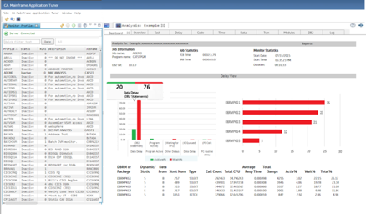
Axure Wireframes, More Testing, Customer Interviews
We removed the pie chart and played with some bar graphs
The color was not appropriate
But it was testing very well
Customers were really liking it
We followed the corporate style guide

Slide 47
Final UI
The design was updated (more neutral colors, etc.) and again tested
All of the customers who reviewed the new dashboard view thought we were giving great high level information.
Additional agile stories were added to the backlog for enhancements to add reporting / email notifications etc. to the page.

Slide 48
What would I do differently?
I would have insisted that more members of the team were involved in the Design Studio at the very beginning.

Slide 49
Other

Slide 50
Competitive Analysis
This demonstrates
  The process used
  Challenges

Slide 51
Competitive Analysis Project
Leadership requested a competitive analysis for a new project: Mainframe as a Service (aka Hyperscale Cloud Services)
3 Researchers collaborated on this project

Slide 52
Our Agenda
  Goals of our analysis
1
The competitors
2
  10 design principles
3
Key Takeaways & Next Steps
4

Slide 53
Goals of Our Analysis
Take the best aspects from popular cloud computing tools in order to design a great experience for our customers
Analyze the services and tools offered by competitors to better understand the benchmark for our capabilities
Establish design principles that will support us as we determine the best approach for our solution

Slide 54
Key Characteristics
We identified the key characteristics of Cloud Computing
  On-demand self-service
  Easy to consume/set up
  Instant gratification
  Development versus infrastructure
  Elasticity
  Pay as you go
  Great user experience!
  Cloud has been successful not only due to WHAT capabilities it provides, but HOW it provides them.

Slide 55

Identify Competitors
We identified the all the competitors and selected the top products for analysis
We had the PM review the list to ensure these were the right ones to compare

Slide 56
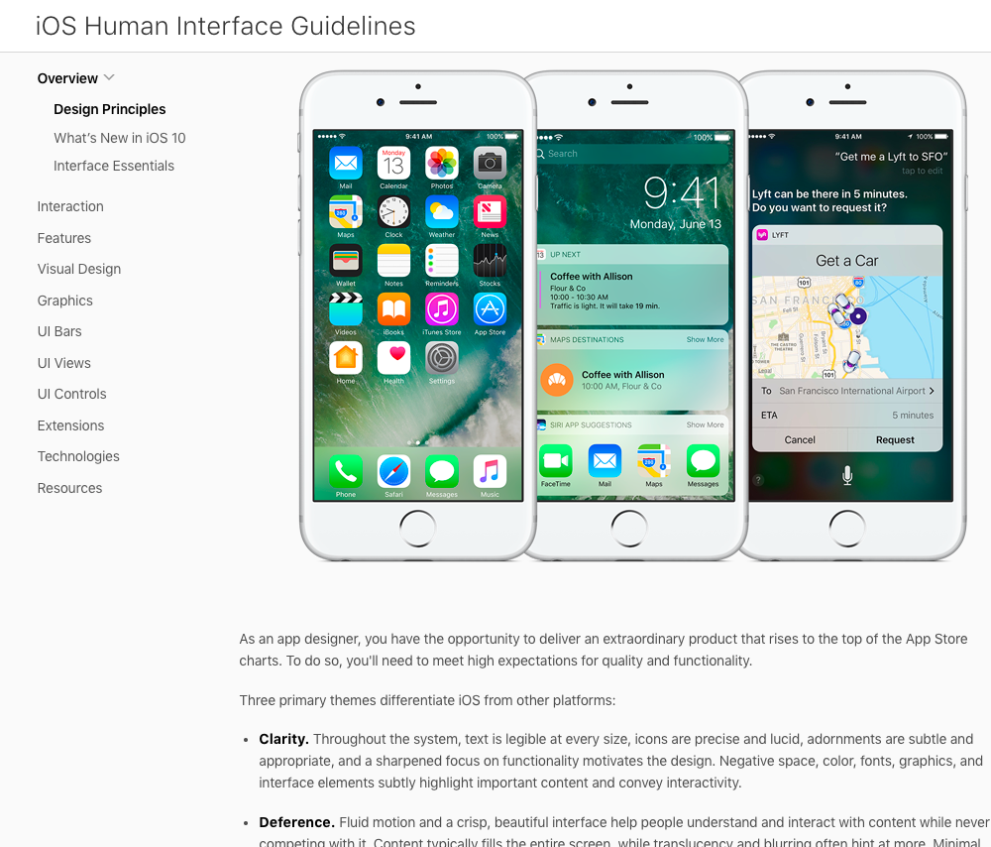
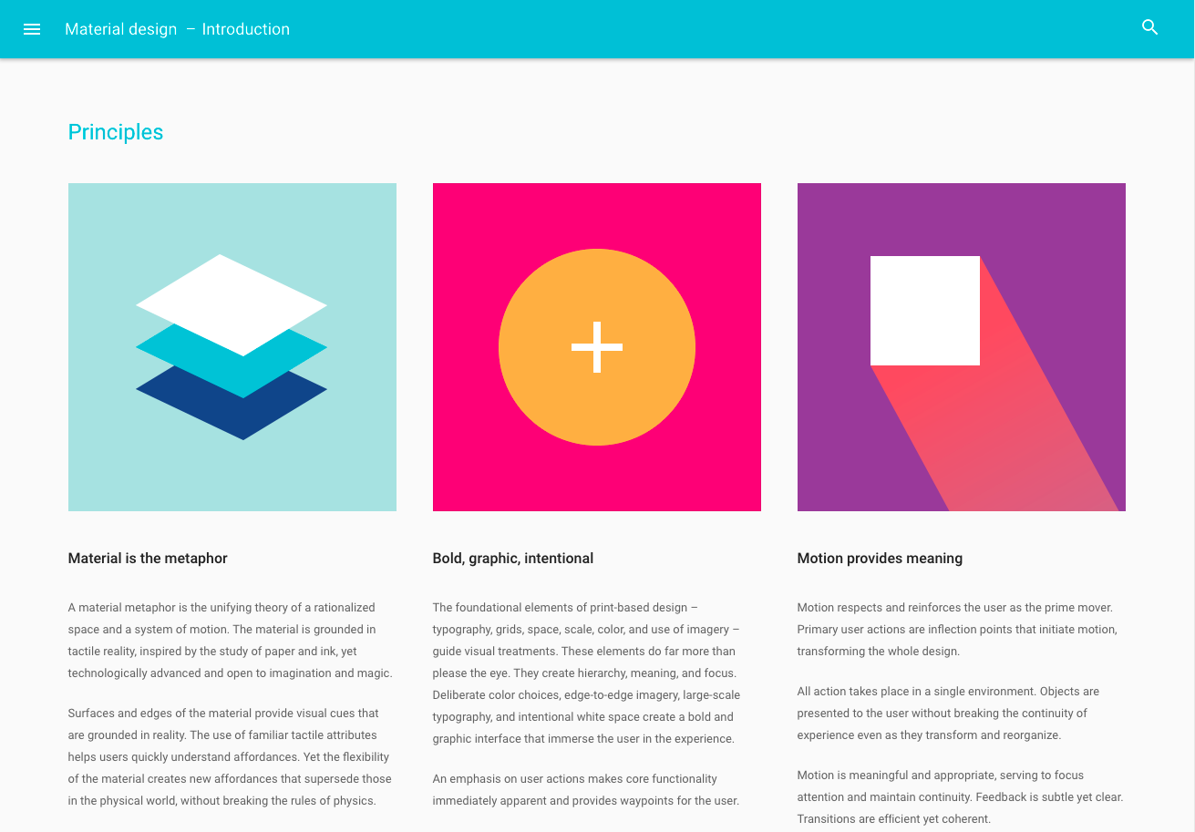
Design principles are the guiding light for any software application.” – LukeW, Product Director at Google
Apple’s Human Interface Guidelines
Google’s Material Design Principles

Slide 57
10 Design Principles
  Lessen the barrier to entry
  Offer clear search capabilities
  Guide the user’s path
  Anticipate the user’s next task
  Make it easy to navigate
  Apply effective visual design
  Provide a consistent experience
  Offer a helping hand
  Provide clear dashboards
  Make App Dev easy

Slide 58
Workflows
We identified and documented the workflows that we would use for this analysis
Created workflow diagrams
Reviewed with PM

Slide 59
1. Lessen the barrier to entry
Make it easy for customers of all levels to get up and running quickly

Slide 60
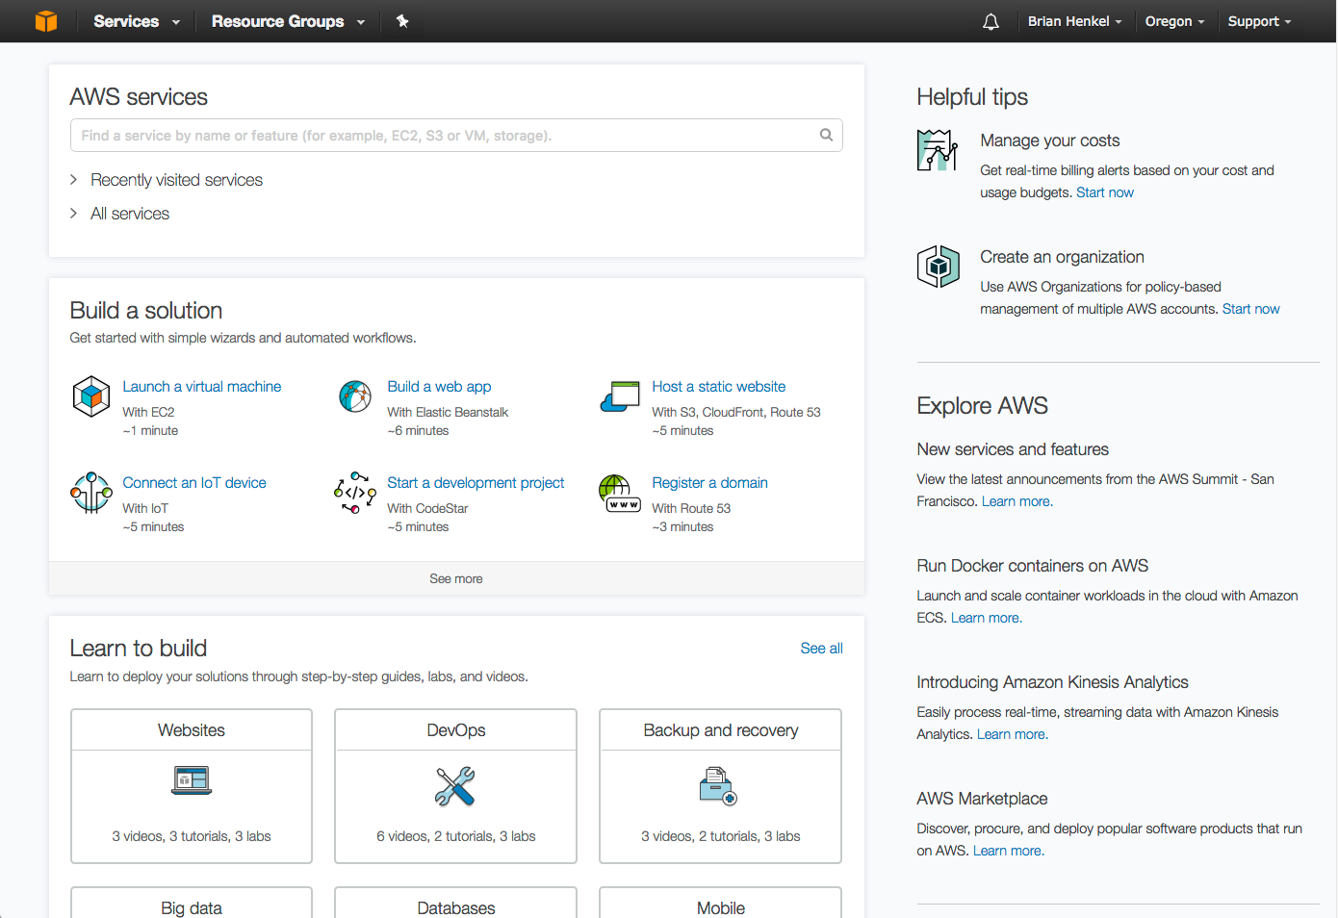
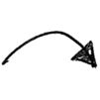
  Prominent search
  Amazon console page (i.e. home page)
  Quick access to recent services
  Surfaces common task using action-oriented language
  Learning modules
  Design Principle #1: Lessen the Barrier to Entry

Slide 61
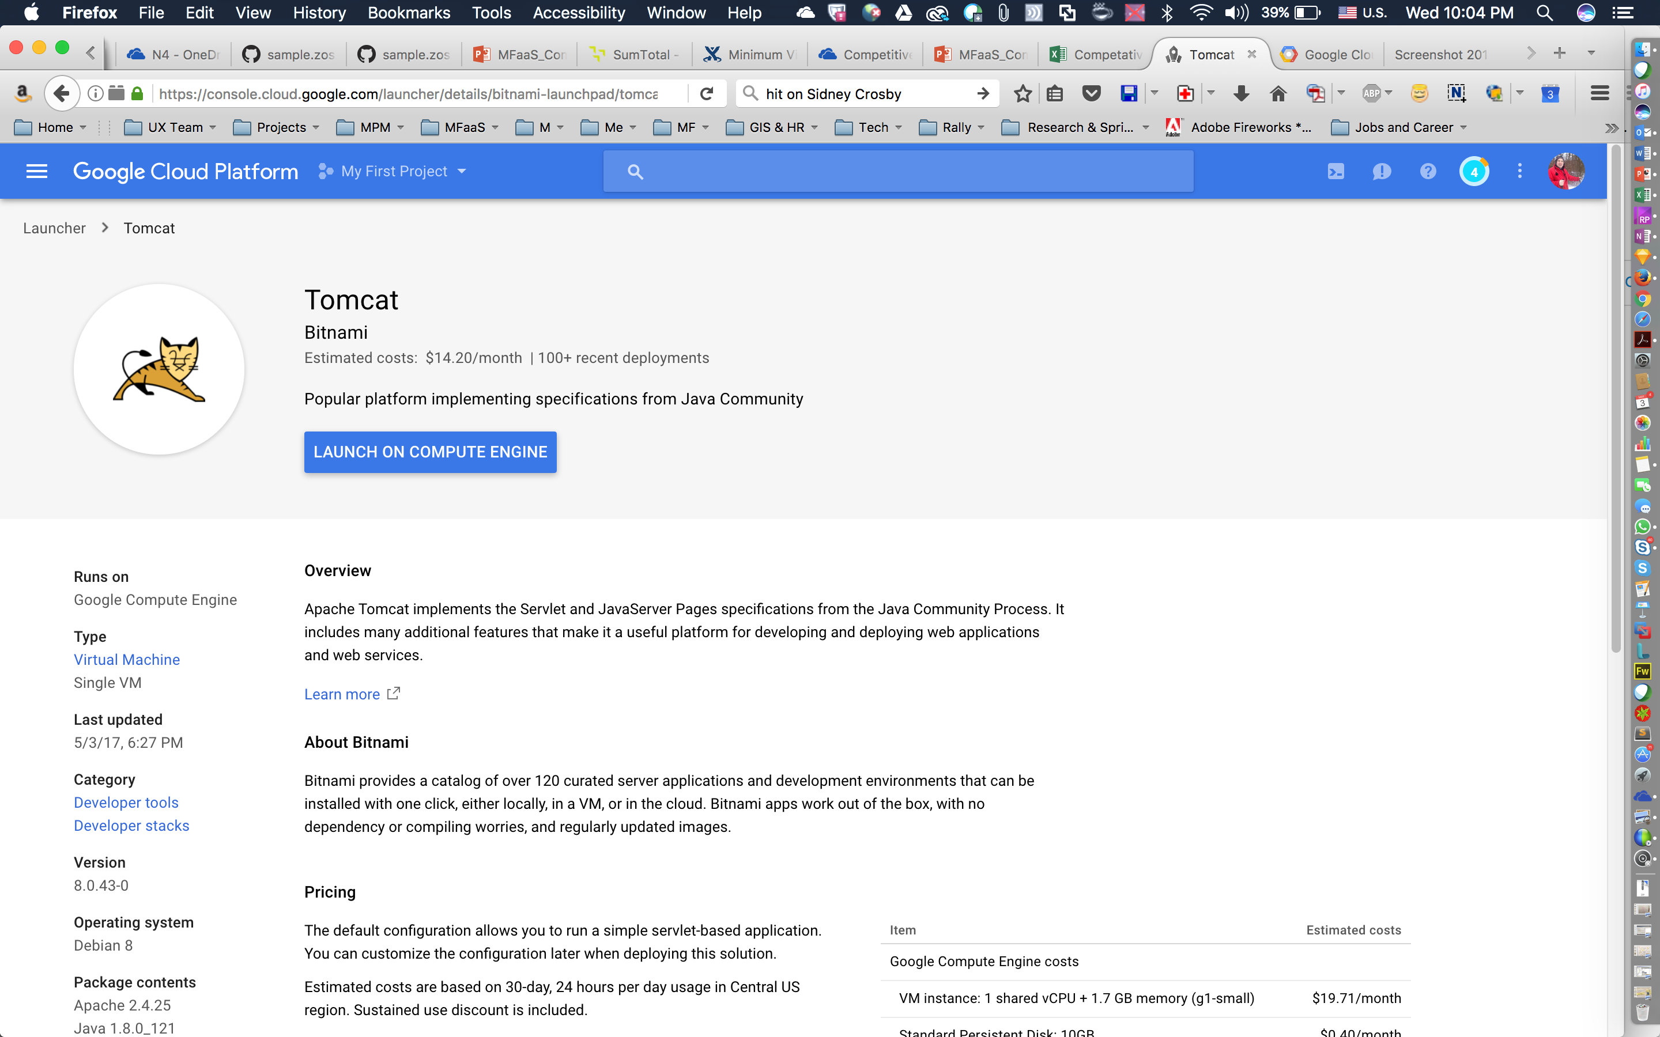
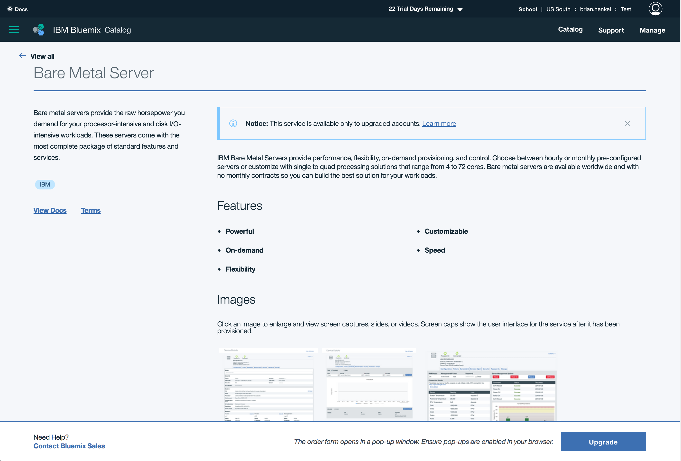
  After choosing a service, overview pages describe the service, its prerequisites, and offer relevant tips and tutorials.
  Strong CTA
  Overview/description
  Overview & specs
  Access to documentation
  Pricing info
  Graphics to show tools/service
  Strong CTA
  Design Principle #1: Lessen the Barrier to Entry

Slide 62
2. Offer clear search capabilities
Make it easy for the user to find what they need

Slide 63
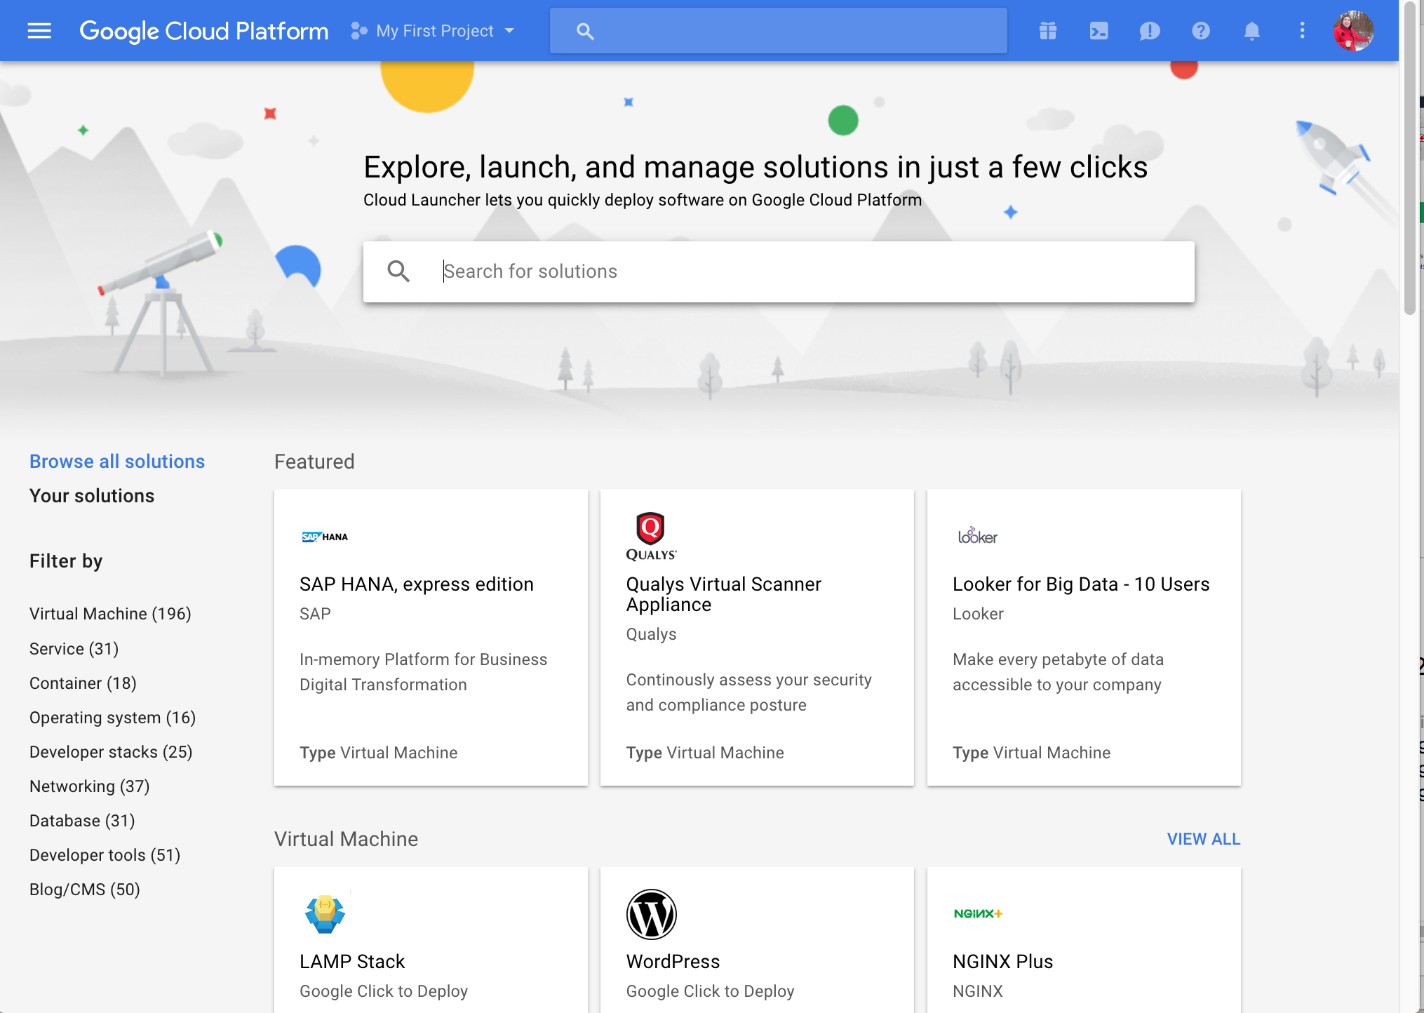
  Prominent search (with autocomplete)
  Google’s Cloud Launcher makes it easy to find and launch the software you’re looking for.
  Filter criteria
  Well-organized display of services with descriptors.
  Design Principle #2: Offer clear search capabilities

Slide 64
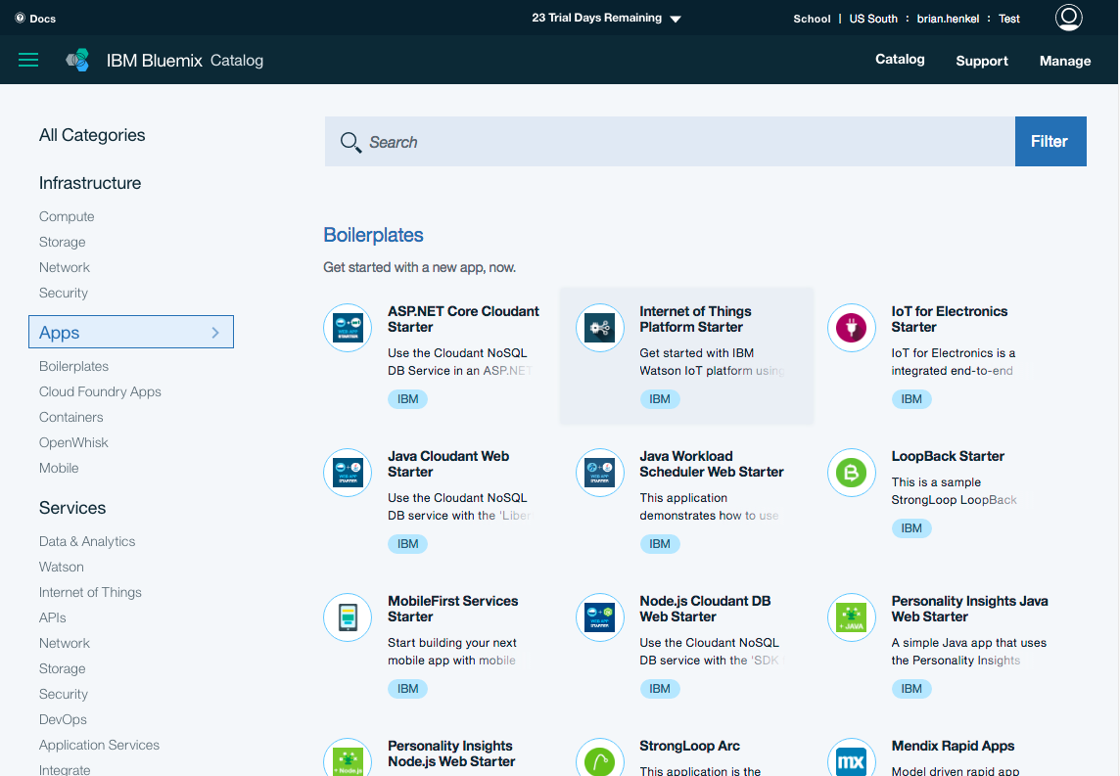
  Bluemix uses a similar layout for searching and filtering services.
  Well-organized display of services with descriptors.
  Design Principle #2: Offer clear search capabilities

Slide 65
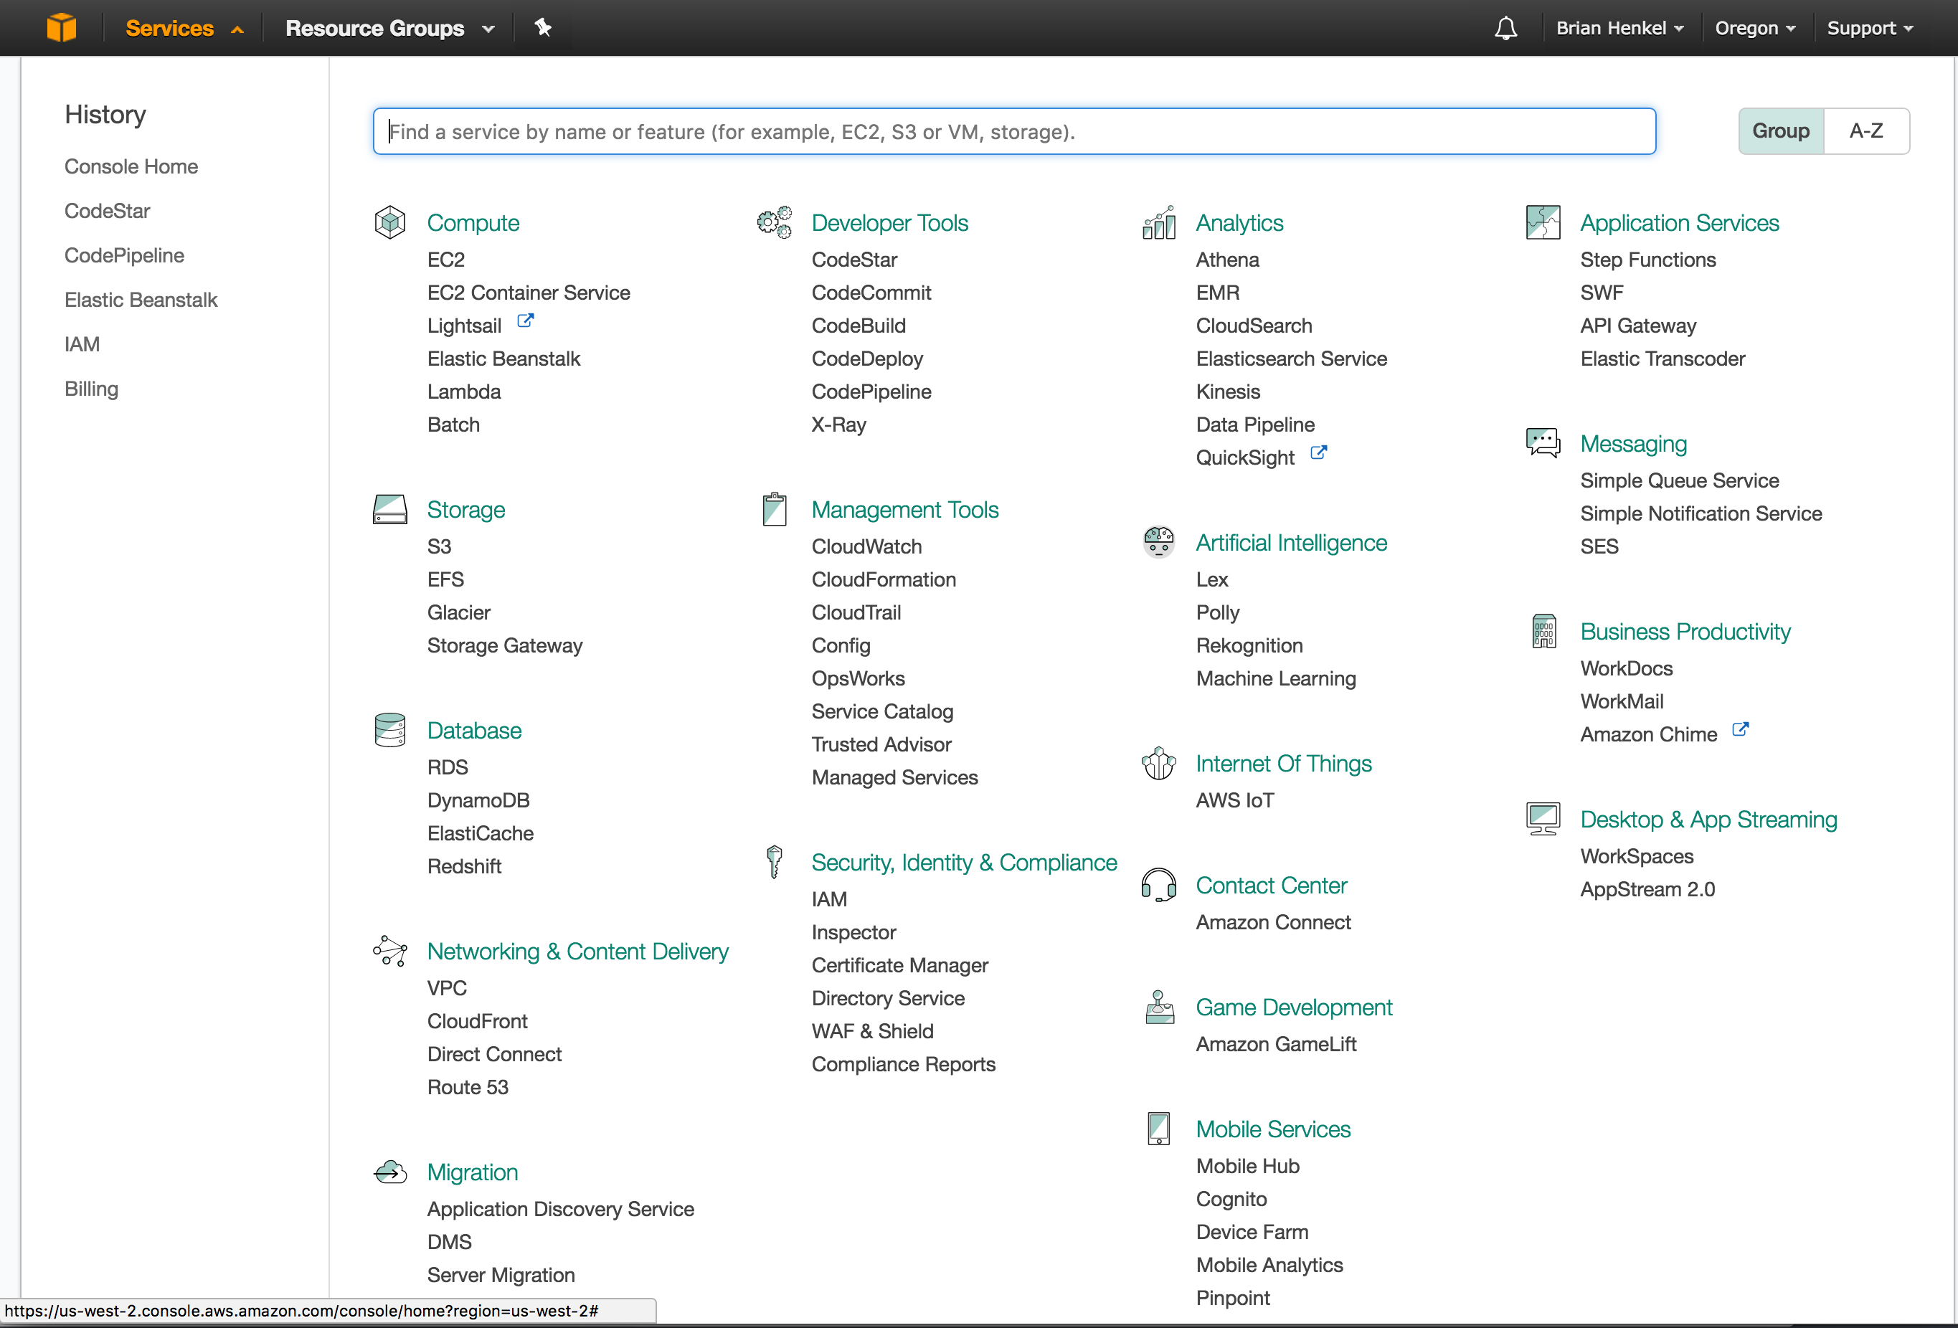
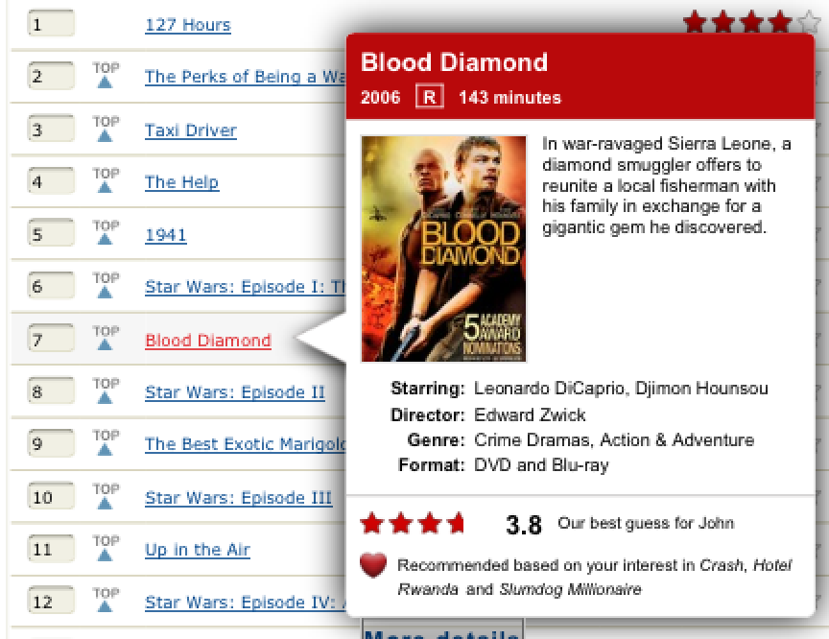
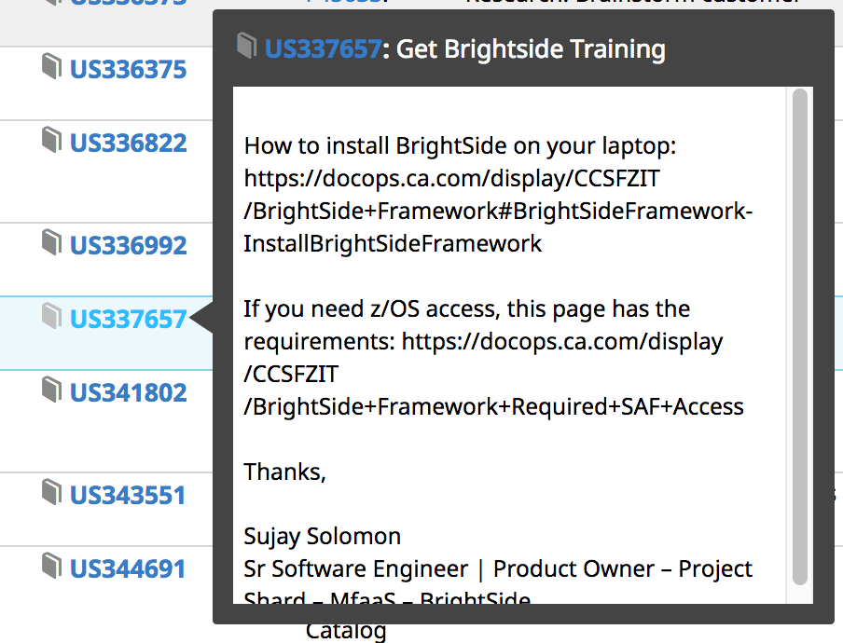
  Proper white space separates offerings into categories that are easy to navigate.
  AWS offers compact single line items in the service catalog. Other sites like Bluemix offer more detail. A workaround for this is to show details in popups. Both Agile Central and Netflix offer this.
  AWS tracks the navigation history of the user, making it easy to access previously-used tools
  Design Principle #2: Offer clear search capabilities

Slide 66
3. Guide the user’s path
Workflows should be clear and explain the process as a user progresses through a task

Slide 67
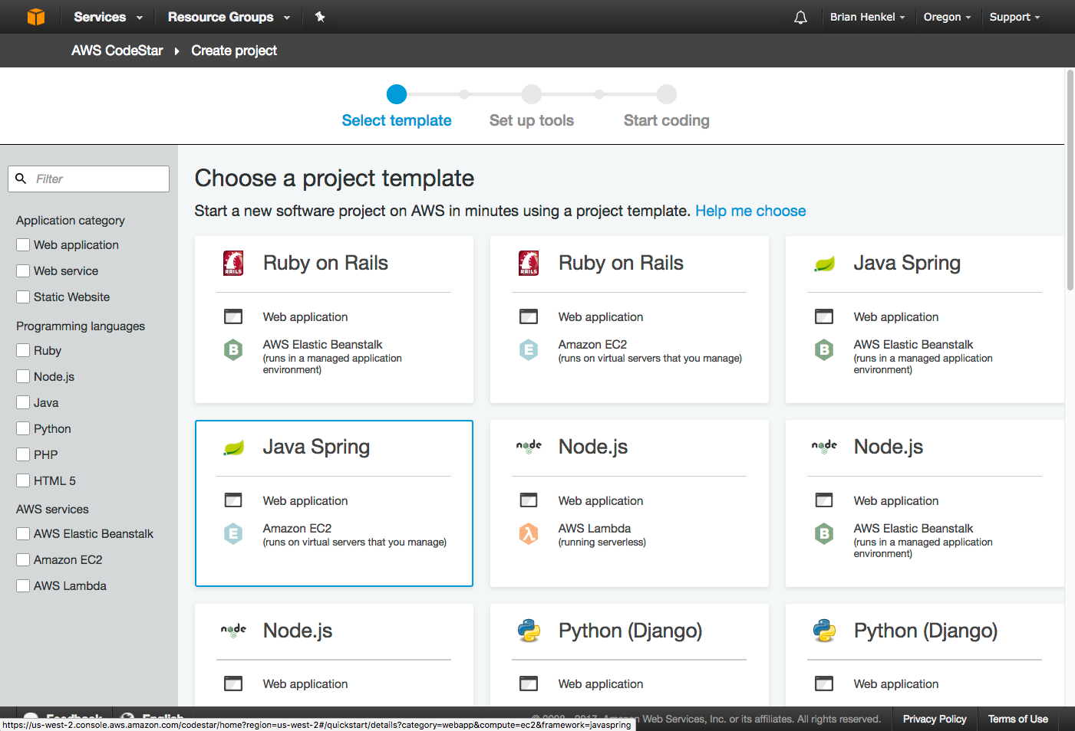
  I know how many steps there are and where I am in the process.
  Amazon walks users through clear steps, offering guidance along the way.
  Contextual help if I am confused.
  Design Principle #3: Guide the user’s path

Slide 68

  As a user, I can see the steps required and where I am in the process.
  Design Principle #3: Guide the user’s path

Slide 69

  Conversational language
  Amazon could have chose an alternate pattern instead:
  Exposes the choices while explaining each one
  Store Files in the Cloud
  Select…
  Not Required
  Single location
  Further description / contextual help
  Global CDN
  Informs that changes have been saved
  Anticipates the user’s next task
  Design Principle #3: Guide the user’s path

Slide 70
4. Anticipate the user’s next task
Surface information relevant to the user’s task and anticipate what they may want to do next

Slide 71


  The stages of development are outlined clearly and the user can go into each of these to configure
  Offers information such as videos while you wait
  Informs user of status
  Progressively loads dashboard area for user to browse.
  Offers a lot of useful information on next steps on the final page of provisioning
  Service launches…
  …upon launch, takes user to hub to manage service
  Design Principle #4: Anticipate the user’s next task

Slide 72

  Display status of installation
  Bluemix adopts similar characteristics, keeping the user informed of the current task but also anticipating the next.
  Highlight the navigation and the options associated with the service/app
  Informs user of the prerequisites for the application or service
  Provide additional instruction
  Design Principle #4: Anticipate the user’s next task

Slide 73
5. Make it easy to navigate
Provide an intuitive structure for navigating between services/tools

Slide 74


  Simple top-level navigation makes it easy to browse without fear of getting lost
  Friendly tabs/menu allow user to navigate between sections
  Design Principle #5: Make it easy to navigate

Slide 75

  Unlimited number of open windows can become unwieldy
  Navigation overload
  Design Principle #5: Make it easy to navigate

Slide 76




  Navigation is hidden into a hamburger menu. This may work well for a mobile site but not so great to hide it.
The terminology is often abstract.
Where are things? For example, I want a Apache Tomcat server, use PHP, and use mySQL. They are in there somewhere.
The hierarchy and ranking is questionable. I’d put SQL first in storage rather than the sexy but less used BigTable.
~ AppDev
~ DevOps
~ java vm
~ monitoring
performance
~ APIs
~ a linux box
~ Analytics
~ Reporting
~ databases
  Design Principle #5: Make it easy to navigate

Slide 77
6. Apply Effective Visual Design
Graphics and styling can affect perceived value

Slide 78


  Lack of white space or visual hierarchy can make a page seem ”busy”
  Proper use of white space and clean graphics makes this feel easy to use
  Design Principle #6: Apply Effective Visual Design

Slide 79

  Microsoft Azure uses strong visual design to create a professional-looking workspace.
  Design Principle #6: Apply Effective Visual Design

Slide 80
7. Maintain a consistent experience
Users should not have to re-learn a UI when navigating different areas of your website

Slide 81




  Depending on where you navigate and what tools you use in AWS, your experience may feel very different.
  Design Principle #7: Maintain a consistent experience

Slide 82






  Bluemix does a good job of maintaining a consistent user experience.

Slide 83
8. Offer a helping hand
Provide just-in-time instructions, tutorials, customer support, and access to training

Slide 84



  Guided tutorials walk a user through a task
  Amazon provides guidance as selections are made
  Design Principle #8: Offer a helping hand
  Design Principle #8: Offer a helping hand

Slide 85

  Automated messaging offers customer support
  Support options persist in the main navigation.
  Design Principle #8: Offer a helping hand

Slide 86


  Amazon excels at providing training, both in-person and with videos and documentation
  MS Azure offers Quickstart Tutorials
  Design Principle #8: Offer a helping hand

Slide 87

Documentation is underplayed. It is available but it doesn’t receive any promotion.
A key takeaway with AWS is that they promote help, tutorials, next steps to guide the user and help them in context of the situation the user is in. Here, help seems like more of an afterthought.
Terse and brief

Slide 88
9. Provide clear and helpful dashboards
Dashboards should provide useful metrics without overwhelming users

Slide 89
Types of Dashboards
Individual service/app level
Across suite of apps/services
Across account

Slide 90


  Amazon offers dashboards at the individual instance/service level, but not broader than this.

Slide 91
  Bluemix keeps its dashboard simple, showing the apps and services I have created.
  A drawback is that they don’t offer much in the way of performance monitoring.
  TBD

Slide 92

  Google provides a dashboard containing the gamut of information at the user’s account level.
  A drawback is that it lacks detailed information.

Slide 93
10. Make App Dev Easy
Simplify Application Development with continuous integration and DevOps tools

Slide 94
Typical Service Catalog Workflow for Development
Provisioning Flow
1
Service Catalog
&
Search
2
Landing Page for Development Service
3
Create a
Project
4
Wizard - Installation & Configuration
5
Finish
Post Provisioning
Code
Build
Deploy
Monitoring

Slide 95

1
2
3
4
5
  Bluemix offers an end-to-end development flow that includes easy setup with other IBM and third-party tools.
  The phases of development are listed. These are all common in the cloud platform products to configure in a hand-holding manner.
  We should keep this lesson in mind for Brightside. Setting up environments is critical factor and as you’ll see, AWS does this very smoothly. Offering a good user experience in getting set up is valuable.
  Design Principle #10: Make App Dev easy

Slide 96
1
2
3
4
5
  The landing page gives an overview of the development process. This same sequence is echoed to the user once they provision a project.
  The phases of development
  The names of the Amazon services that handle the respective area of development.
  Design Principle #10: Make App Dev easy

Slide 97


1
2
3
4
5
  The stages of development are outlined clearly and the user can go into each of these to configure.
  AWS offers an end-to-end development flow.
  The phases of development
  The names of the Amazon services that handle a area of development.

Slide 98


1
2
3
4
5
+
C
  AWS comes with a built in GIT repository and a GIT project is automatically created. This is convenient relative to other cloud platforms where you need to have your own GIT repository.
  AWS provides a helpful hand to the developer with this page of instructions for connecting a GIT client and CLI to the GIT repository.
  Design Principle #10: Make App Dev easy

Slide 99

1
2
3
4
5
  OpenShift requires the user provide a GIT repository. They don’t make that apparent from the start and there is no way to save mid-stream.
  AWS has a a final page that includes instructions and the configuration areas are clearly outlined, which gives the user much more assurance.
  Bluemix shares a similar approach to OpenShift.
  Design Principle #10: Make App Dev easy

Slide 100
Final Steps
Identify key takeaways and next steps
Present to the teams
Write agile stories
Begin mockups of potential flows/ideas that take into consideration what we learned

Slide 101
Timeline Samples
Graphics represent the timelines for:
  Usability Testing
  Design Thinking Workshop Prep and Post
  Design Thinking Workshop agendas

Slide 102


Usability Testing Process

Slide 103
UX Design Process
Analysis
Design
Specification
Create paper prototype
Usability test
Test paper prototype with end users
Revise prototype
Test again
Create detailed mockup in Axure
Use components from the Design System
Final usability test
Collaborative Design Studio
Identify all use cases (tasks)
Assumptions, Triggers, Goals
Notated Design
Create workflow diagram
Incorporates all use cases

Slide 104
DTW Process

Slide 105
DTW Agendas

Slide 106
Sample Reports
Thumbnails of Report templates

Slide 107




Sample Usability Report

Slide 108

Design System

Slide 109

Contact
Susie Robson
susrobson@gmail.com
617-435-1089

